Slide 1


DATA-270 Predicting Crime and Proposing Safer Neighborhoods: Using Machine Learning Models
Group 6​

Slide 2

Agenda
Abstract
Chapter 1- Introduction
Chapter 2- Data & Project Management Plan
Chapter 3- Data Engineering
Chapter 4- Modelling
Summary

Slide 3
Abstract
Large amount of data
Identify patterns
Aid authorities, residents and law enforcement agencies
Prediction of potential crime location and times
Leverage past crime data and by utilizing machine learning and data-driven methods, detect areas with an increased likelihood of criminal activity in advance.
Raise public awareness about high-risk areas, and enable authorities to anticipate criminal activities for better allocation of police resources.
Predictive policing aims to enhance public safety through preemptive actions and specific interventions, aiming to prevent incidents from happening.

Slide 4

Introduction
Crime has a significant impact on individuals, families, and societies by causing economic setbacks and social disturbances.
Factors such as socioeconomic inequalities, limited opportunities, substance abuse, and firearm availability contribute to crime in urban areas.
Poverty and unemployment drive illegal activities while societal inequities compound challenges in marginalized neighborhoods.

Slide 5
Objective & Approach
Data Collection
Data Preprocessing
Model Selection
Training & Validation
Evaluation
Final Model
Crime Prevention Through Proactive Measures.
Resource Allocation Optimization.
Public Safety and Awareness.
Reduced Social and Economic Impact.
Making Communities Safer.

Slide 6
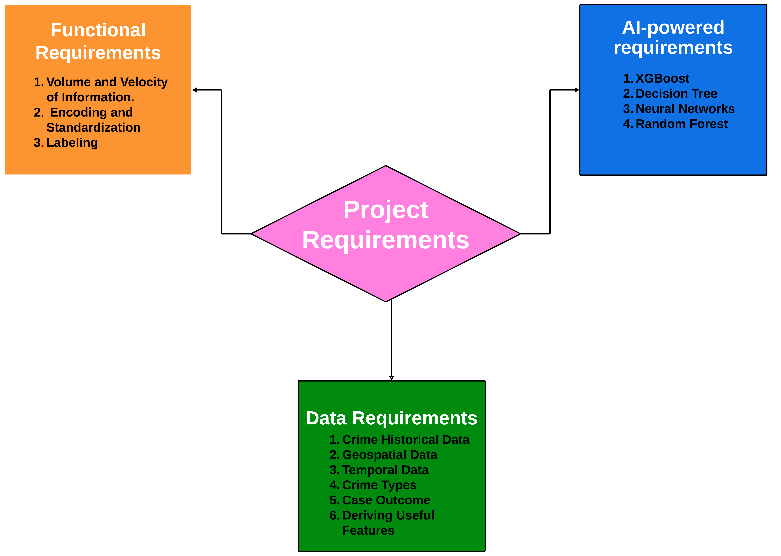
Project Requirements

Slide 7
Technology, Literature and Solution Survey
Lin et al. (2017) proposed a data-driven approach using machine learning to combat drug-related crime in Taiwan, achieving an 87% accuracy. The strategy emphasizes addressing low-level crimes and utilizes the R programming language and the H2O package.
Walczak et al. (2021) utilized neural networks to forecast crime using a dataset from Detroit, achieving 16.4% accuracy for 38 crime categories and an improved accuracy of 27.1% when categorized into seven groups.
Divya et al. (2022) proposed an innovative approach to increase security measures using deep learning and achieved an accuracy pf 79%.
V. Balu et al. (2022) focuses on predicting the likelihood of various crime types as their primary objective.
Kumar et al. (2020) utilized The K-nearest neighbor algorithm to forecast the most common crime in a particular area, yielding a 99% precision when 'k' is configured to 3.
Ahishakiye et al. (2017) predicted crime categories using the decision tree algorithm based on Violent Crimes Per Population, achieving an exceptional accuracy rate of 94.3%.

Slide 8
Technology, Literature and Solution Survey
Bharati et al. (2018) utilized machine learning algorithms to predict crime in Chicago. Achieved high accuracy with decision trees and random forest models.
Shah et al. (2021) Explored the integration of Machine Learning and computer vision in crime prediction, emphasizing ongoing area surveillance for enhanced crime prevention.
Krishnaveni K.P. et al. (2022) Explored different machine learning and deep learning methods for predicting crimes, highlighting the significance of using a variety of data sources and recognizing the difficulties in interpreting models.
Dr. B.S. Jadhav et al. (2021) performed thorough analysis of machine learning methods for predicting criminal behavior, discussing challenges and exploring alternative approaches such as Natural Language Processing and Computer Vision.
J. Arunnehru et al. (2021) developed a system that combines convolutional neural networks and support vector machines for real-time crime intention detection, achieving an accuracy of 95% on a dataset comprising 10,000 video clips.
Grega et al. (2013) created a customized 3D CNN model to detect criminal intentions in cases of shoplifting, achieving a notable accuracy rate of 75% and demonstrating superiority over current systems.

Slide 9
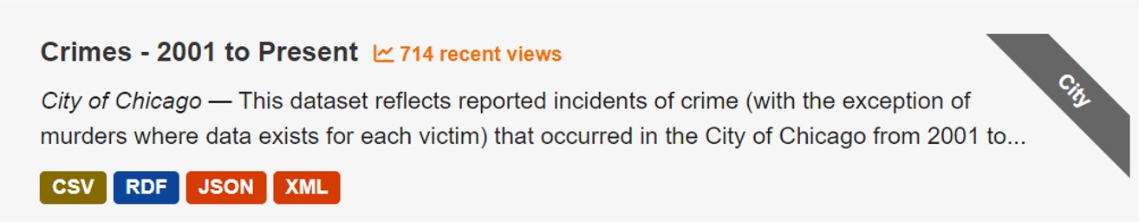
Data Management Plan
We chose Chicago crime dataset – 2001 to present which is of 1.86GB
For storage we have utilized google drive, emphasized the efficient management of data, such as data manipulation, normalization due to its accessibility and collaborative capabilities.
Scheduled to delete Google Drive files by January 01, 2024, yet will keep datasets on Kaggle for accessibility, collaboration, and visibility purposes while ensuring data integrity and openness.

Slide 10
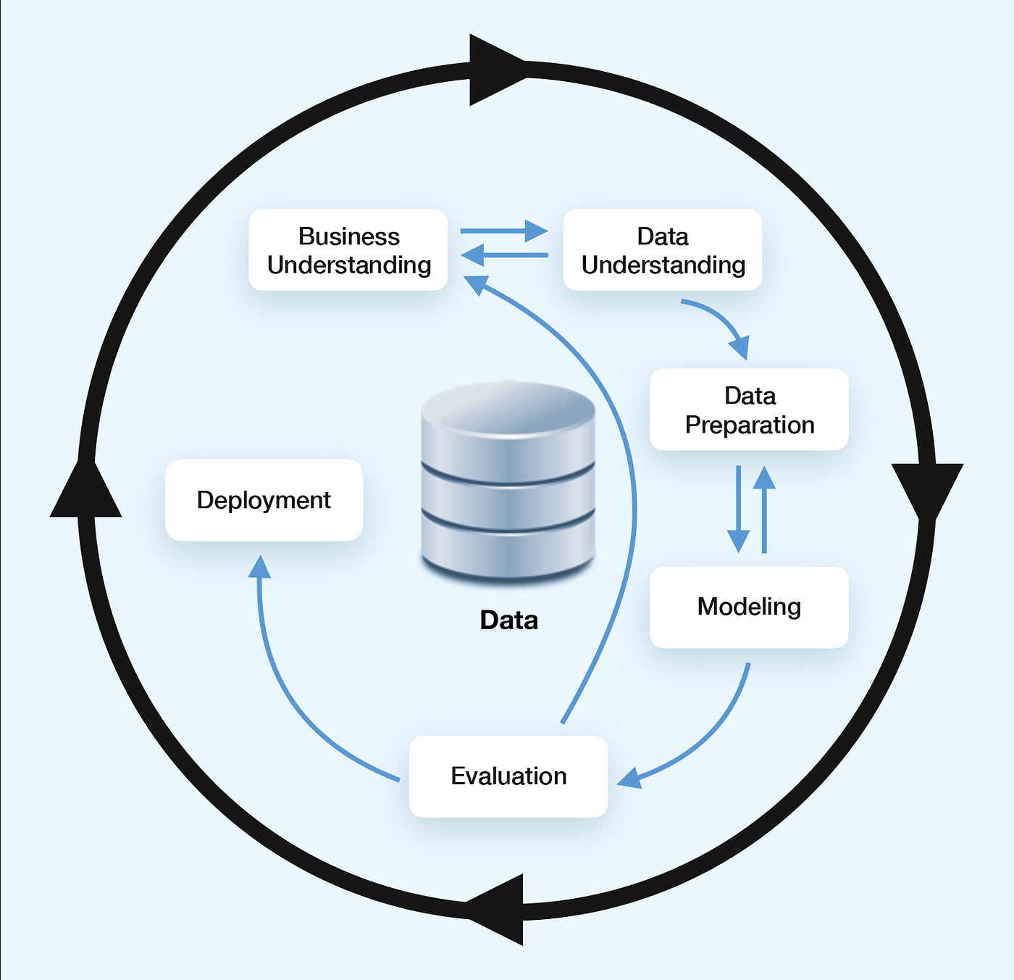
Data Management Plan
Business understanding – Project background, objective, plan
Data understanding – Determine the data required for the targeted problem
Data preparation – Ensure the data well-organized for modeling
Modeling – Multiple models training, validation and testing
Evaluation – Performance evaluation by various metrics
Deployment – Make our work publicly accessible

Slide 11
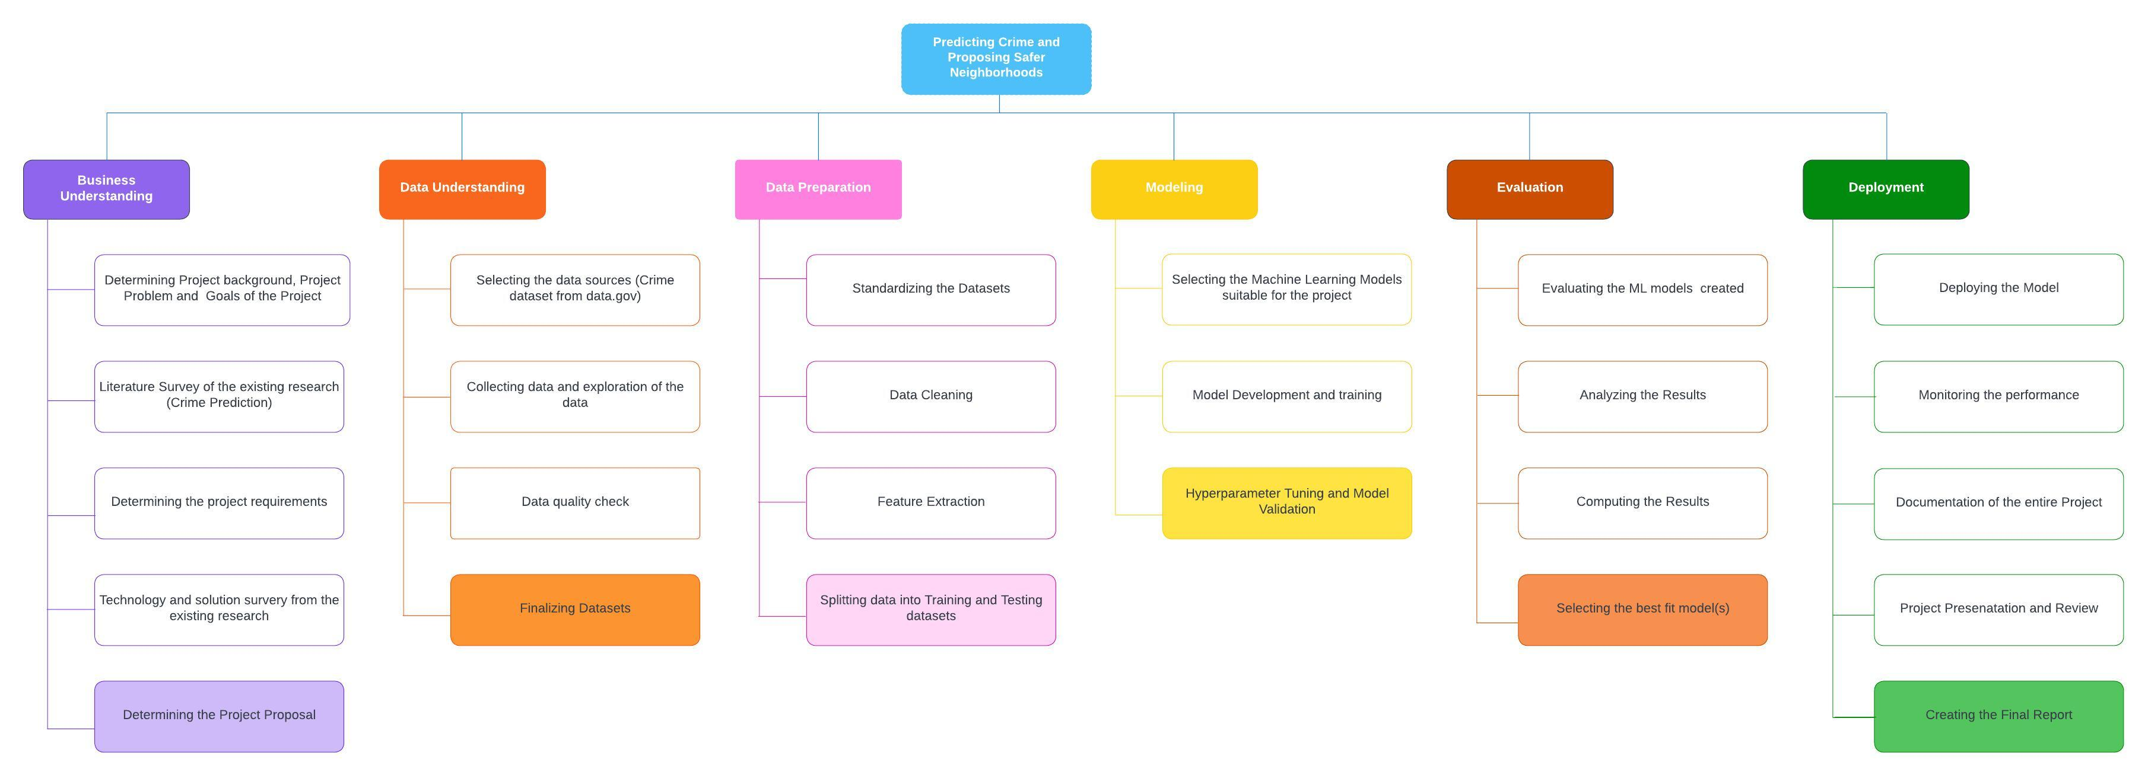
Project Organization Plan-WBS

Slide 12
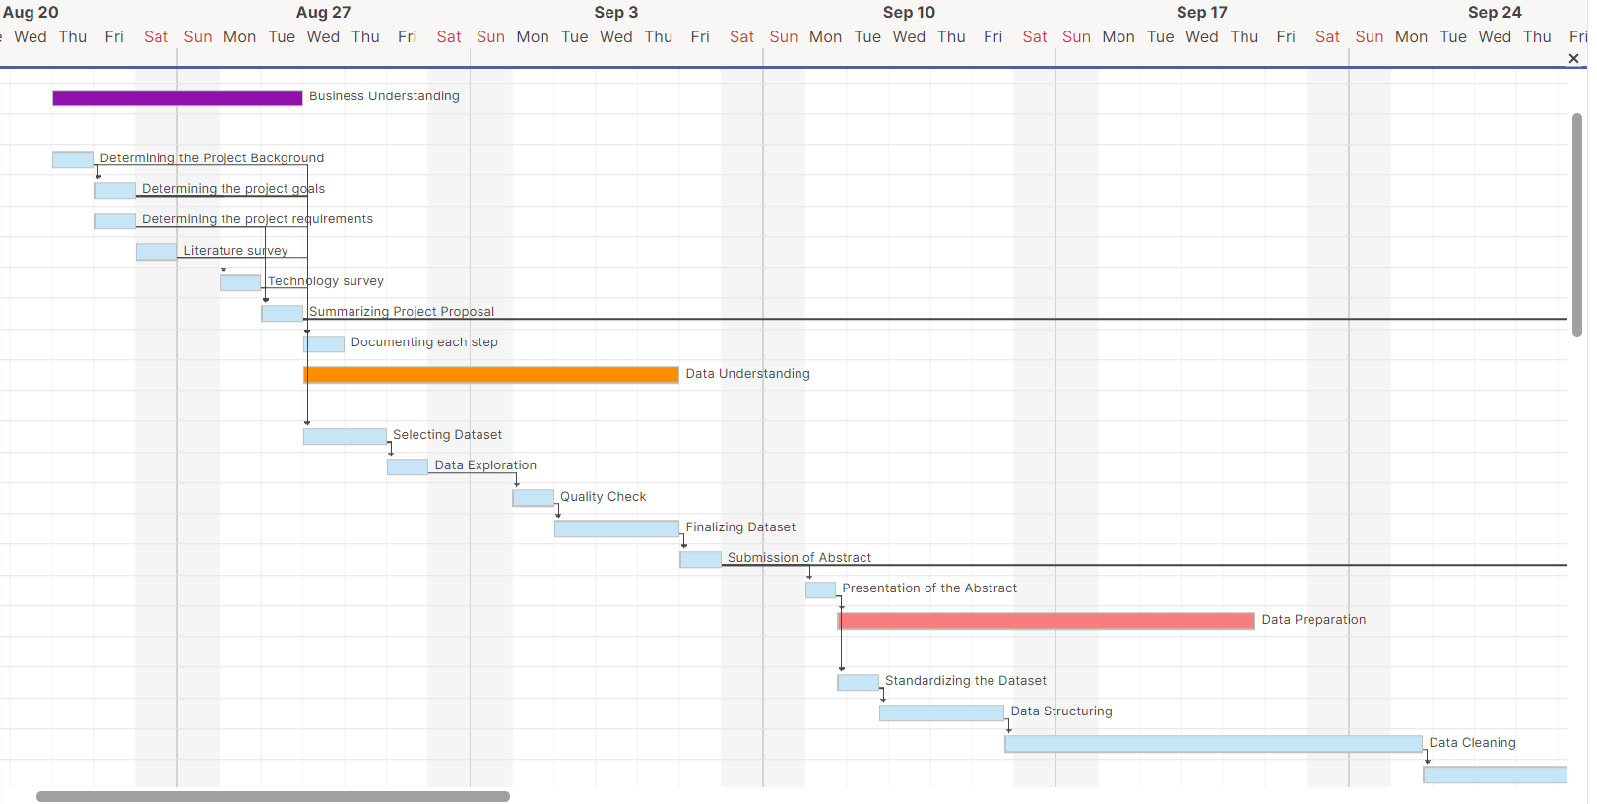
Project Schedule – Gantt Chart

Slide 13
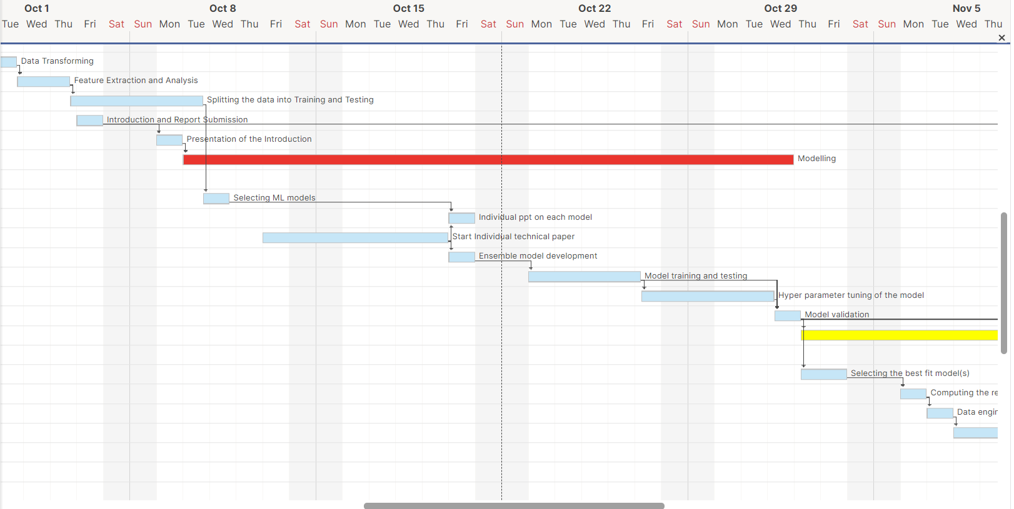
Project Schedule – Gantt Chart

Slide 14
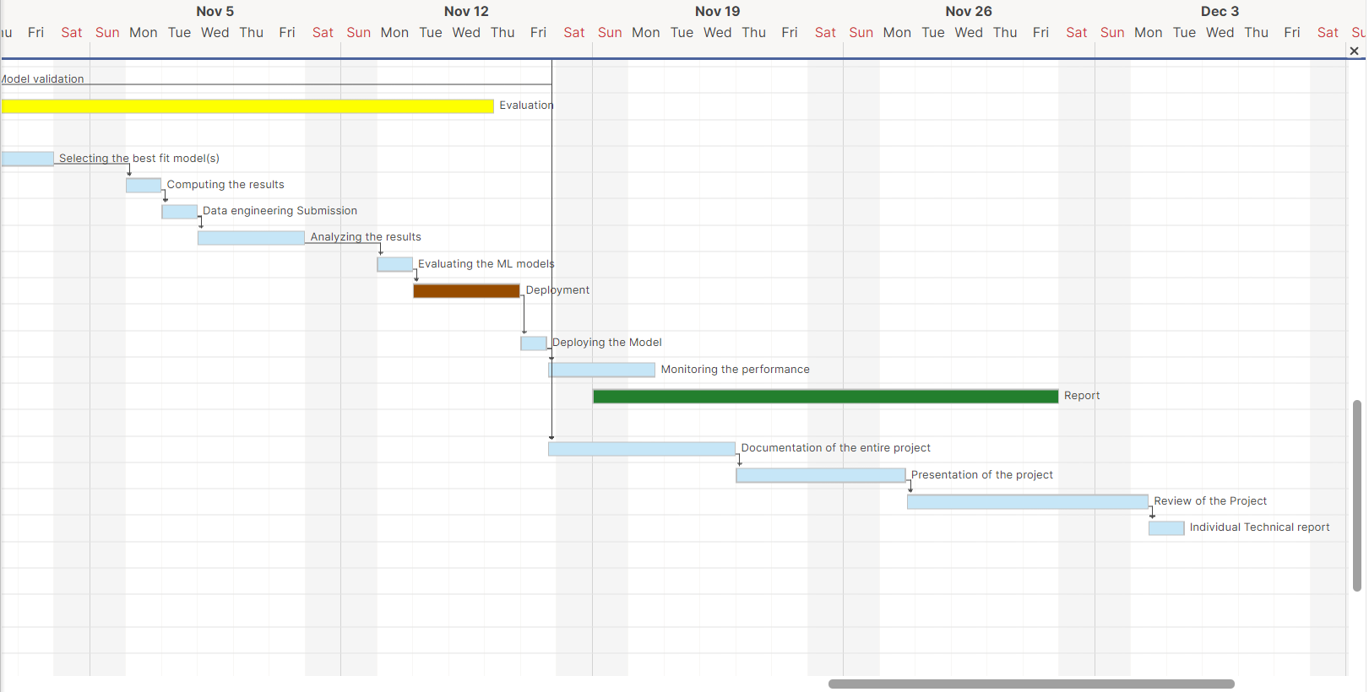
Project Schedule – Gantt Chart

Slide 15
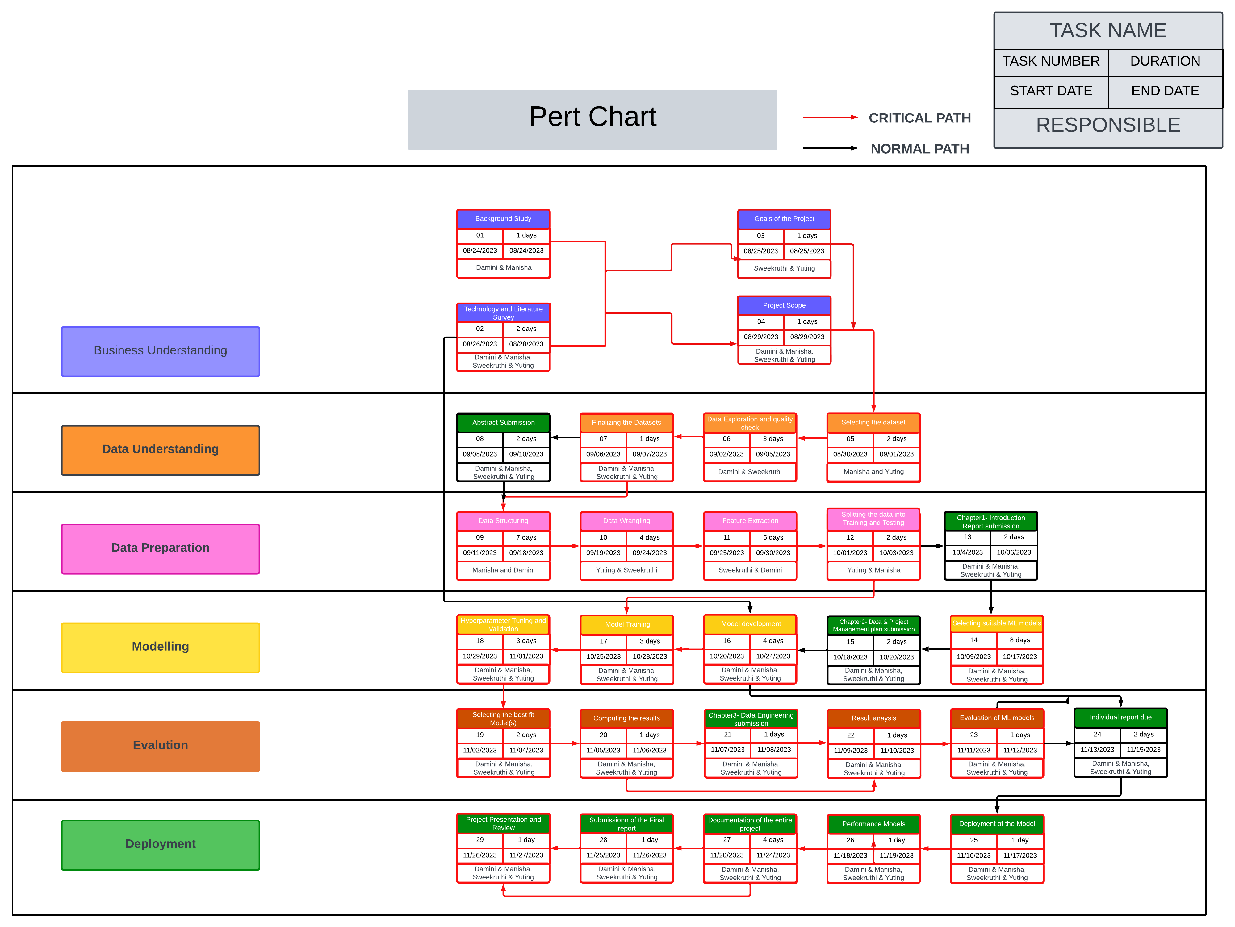
Project Schedule – Pert Chart

Slide 16
Hardware and Software Requirements :
Hardware & Software | Configuration | Duration | Purpose | Cost
Data Storage | Google drive | 2 Months | For storing the CSV files | Free
Local Machine | 64-bit version | 2 Months | For Computations | $900
CPU | Intel Core i7 or AMD Ryzen 7 | 2 Months | For executing instructions and processing data | $300
GPU | Nvidia GeForce RTX 3060 or AMD Radeon RX 6600 | 2 months | machine learning computations | $150
Python | Version 3.12.0 | 2 Months | Programming language for machine learning | Free
NumPy | Version 1.23.3 | 2 Months | Model Deployment | Free
Pandas | Version 1.5.2 | 2 Months | Data analysis and manipulation | Free
Scikit-learn | Version 1.1.3 | 2 Months | Machine learning algorithms | Free
MySQL(Community Edition) | Version 8.0.33 | 2 Months | Production database | Free
Tableau Desktop | 2023.3 | 2 Months | Data visualization | Student License
Python Jupyter Notebook | Version 7.3.1 | 2 Months | Data exploration, Data Pre-processing (Writing python script) | Free

Slide 17
Tools and Licenses
Tools | License | Duration | Purpose | Cost
GitHub | Open source | 2 Months | Project repository | Free
Zoom | Student | 2 Months | Project meetings | Free
Microsoft Office 360 | Student | 2 Months | Reports and presentations (Microsoft tools like word, ppt, excel, etc.) | Free
US government website (Data.gov) | Open source | 2 Months | Collecting the data | Free

Slide 18
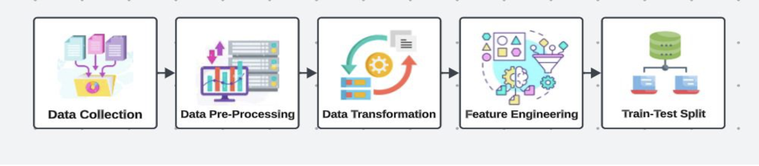
Data Engineering
Data Collection
Utilize various sources like government databases, law enforcement agencies, and openly available datasets.
Obtain the dataset from the government website due to its comprehensibility and reliability.
Data Pre-processing
Clean the data by removing duplicates, handling missing values.
Data Transformation
Encode categorical variables and scale numerical features for consistency and accuracy.
Use Lasso Regression (L1 Regularization) and domain knowledge for feature extraction.
Data Preparation
Split the dataset into training (70%), validation (20%), and test (10%) sets.
Data Statistics
Summarize and display the results of the previous stage in visualization formats.

Slide 19
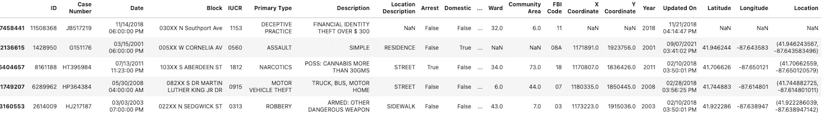
Data Collection-Sample Data Collected From data.gov

Slide 20
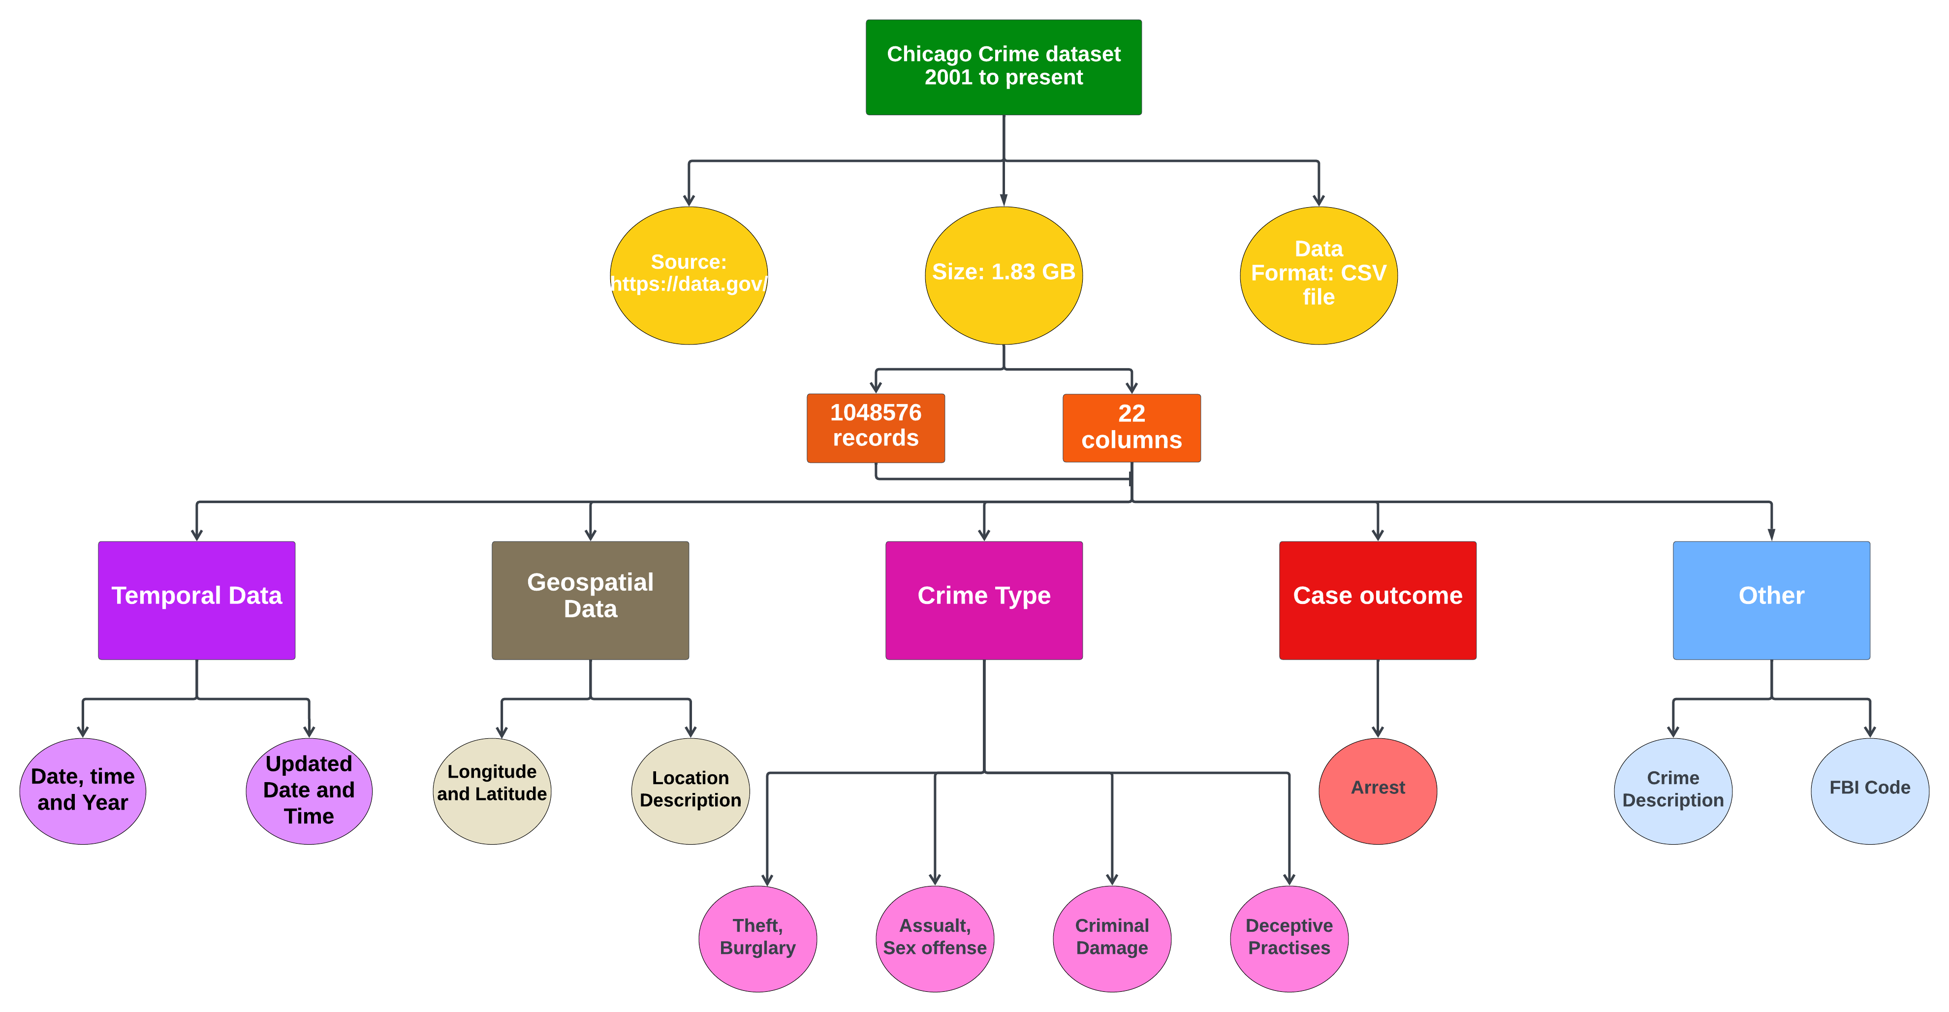
Dataset description

Slide 21
Data Collection-Sample Data Collected From data.gov

Slide 22
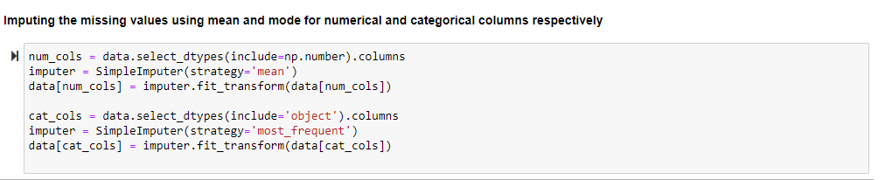
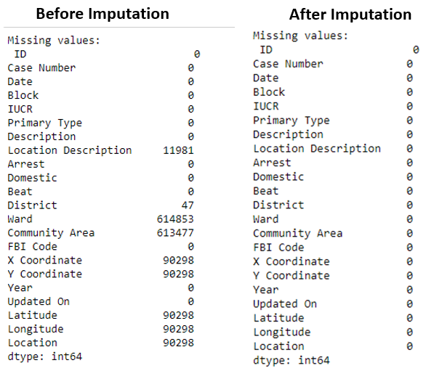
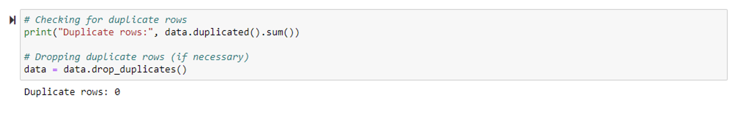
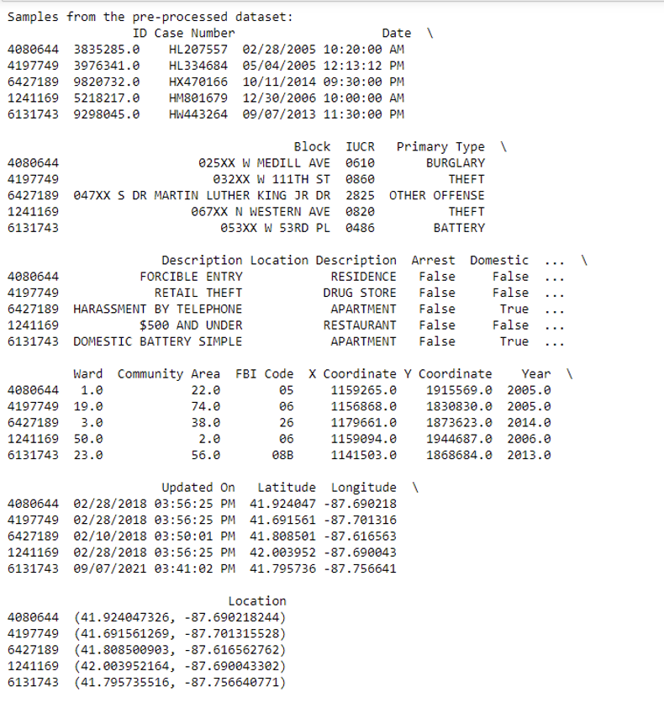
Data Pre-processing

Slide 23
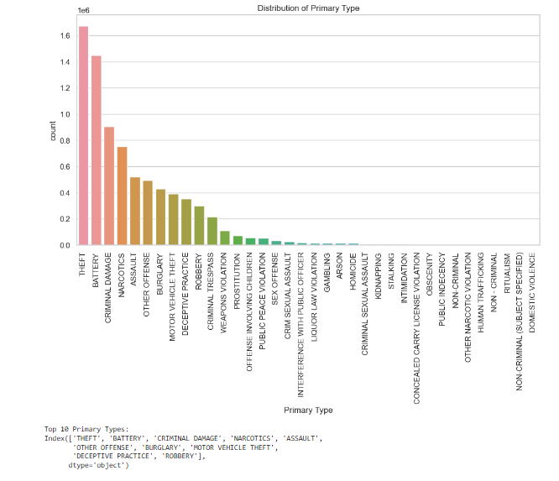
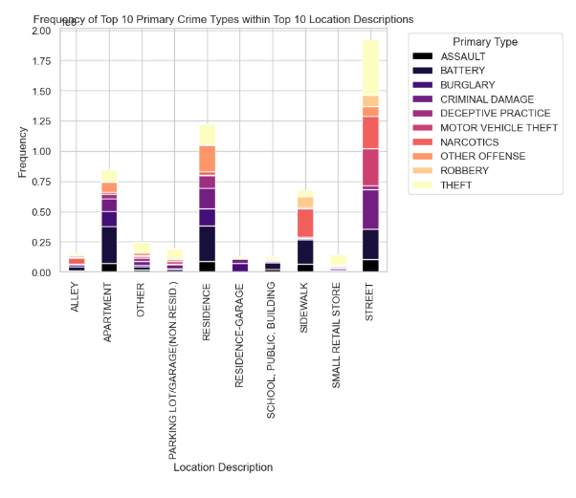
Exploratory Data Analysis

Slide 24
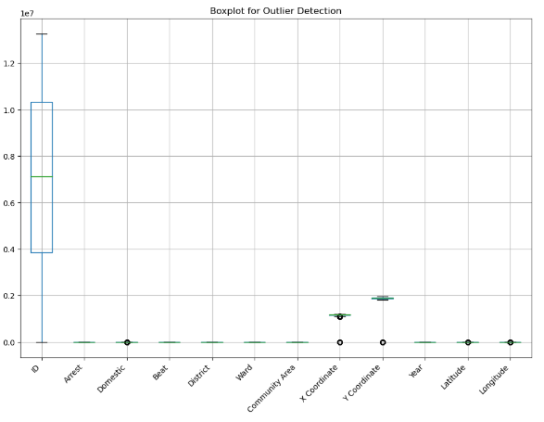
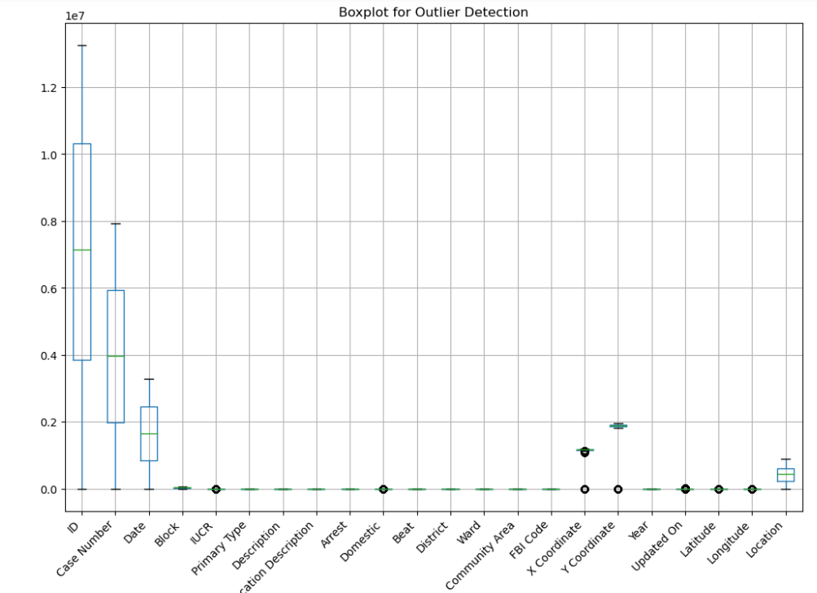
Outlier detection analysis
Outlier analysis before encoding
Outlier analysis after encoding

Slide 25
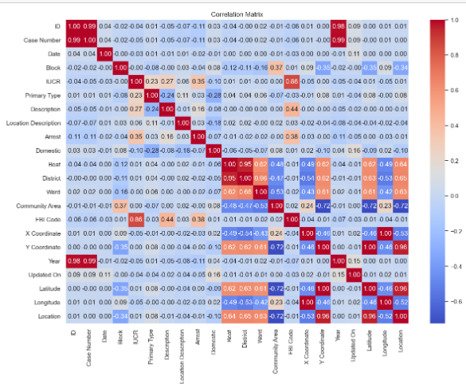
Correlation analysis
Correlation analysis provides a basis for understanding potential relationships between the target variable 'Primary Type' and other variables.
Guides the development of features and models for predicting crime types.

Slide 26
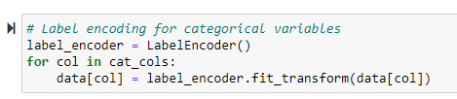
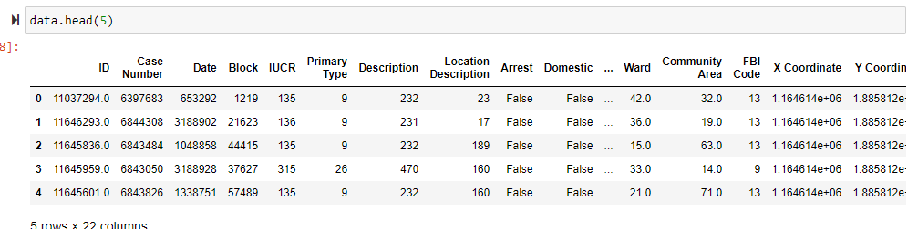
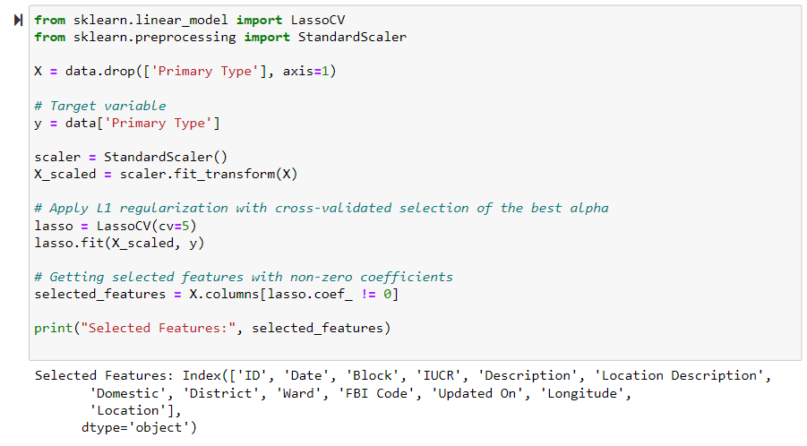
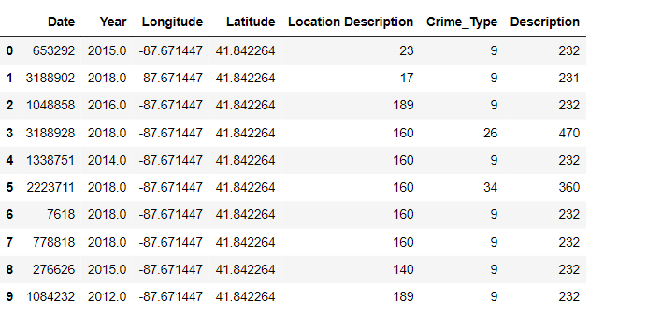
Data Transformation
Label encoding is used to transform categorical values into numerical values.
Lasso Regression is used for feature selection.
‘Primary Type’ is renamed to ‘Crime_Type’.

Slide 27
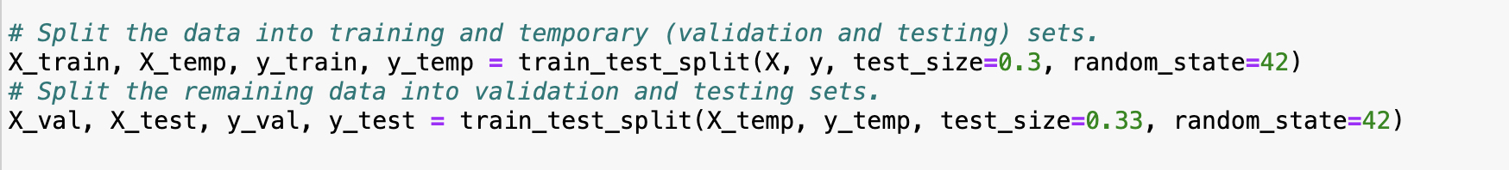
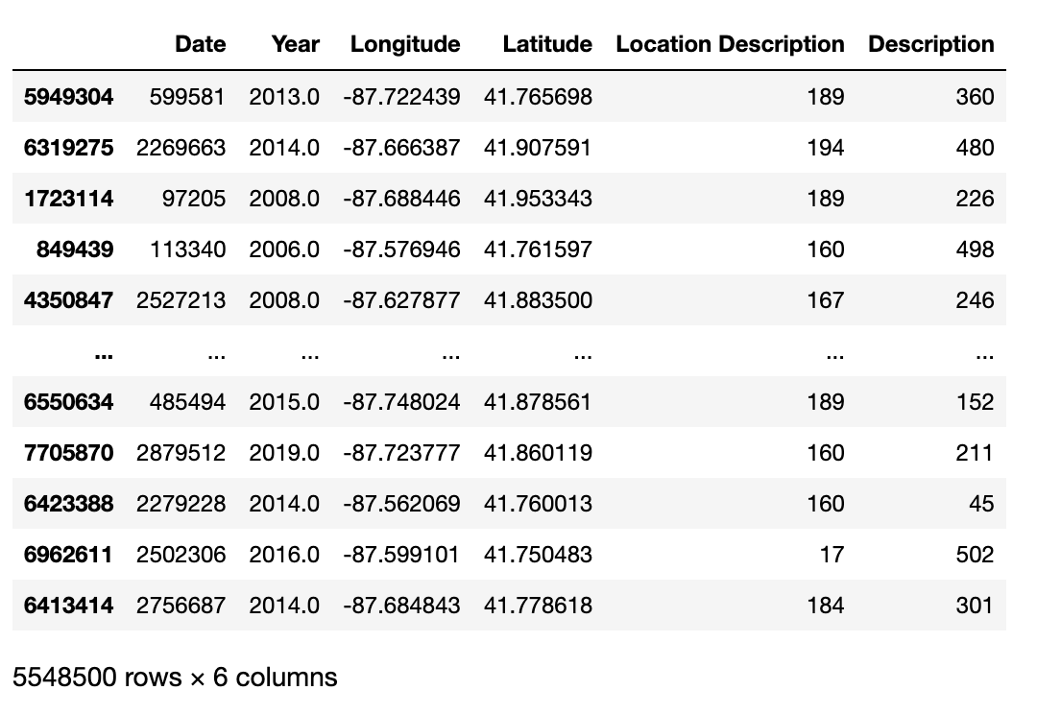
Data Preparation
Sample of training data
Training dataset is used to capture underlying patterns.
The validation dataset is for hyperparameter tuning purpose.
The testing dataset is employed to evaluate the performance

Slide 28
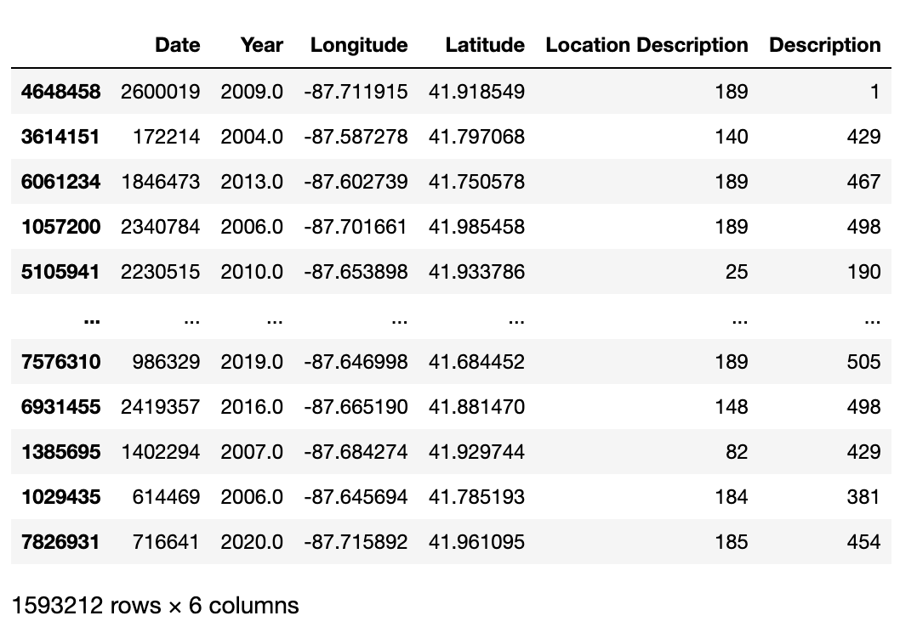
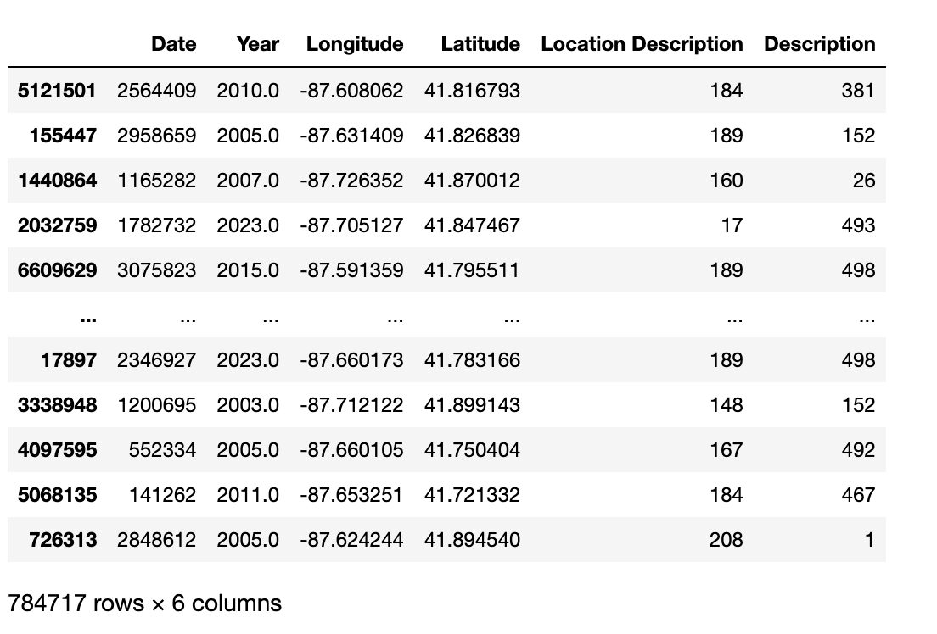
Data Preparation
Sample From the Validation Dataset
Sample From the Testing Dataset

Slide 29
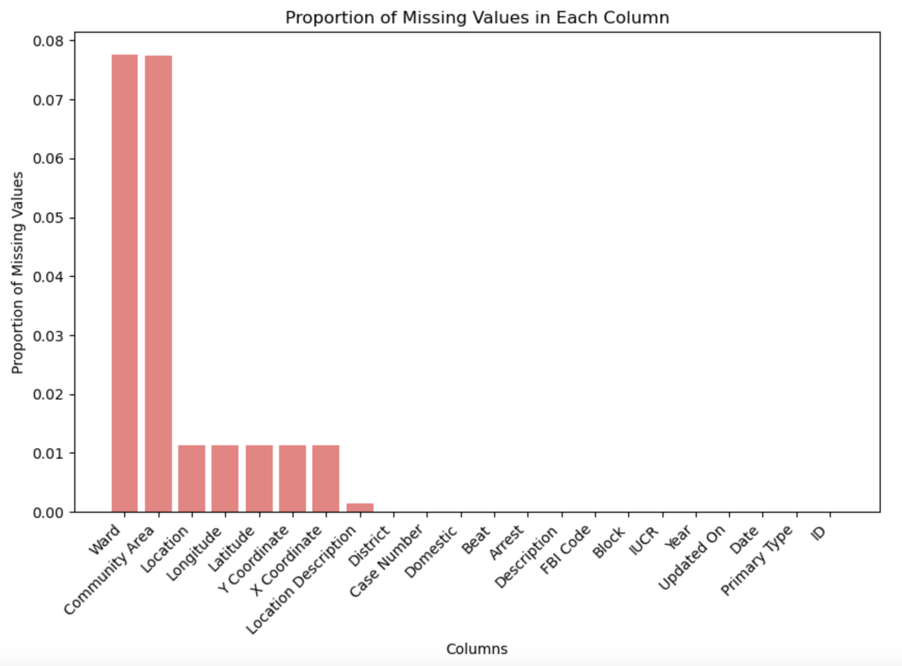
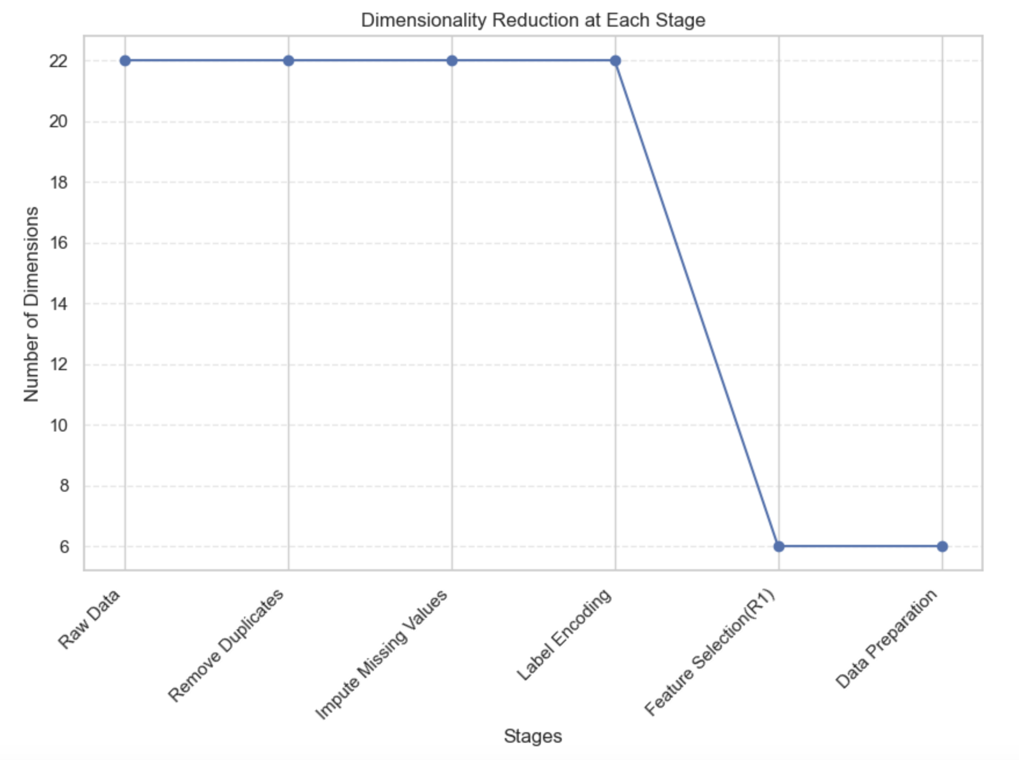
Data Statistics

Slide 30
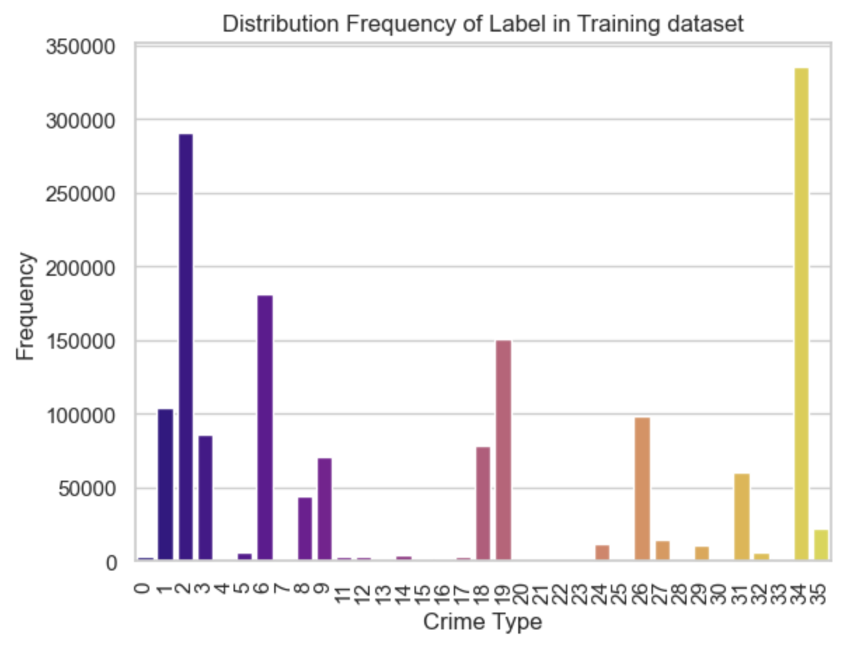
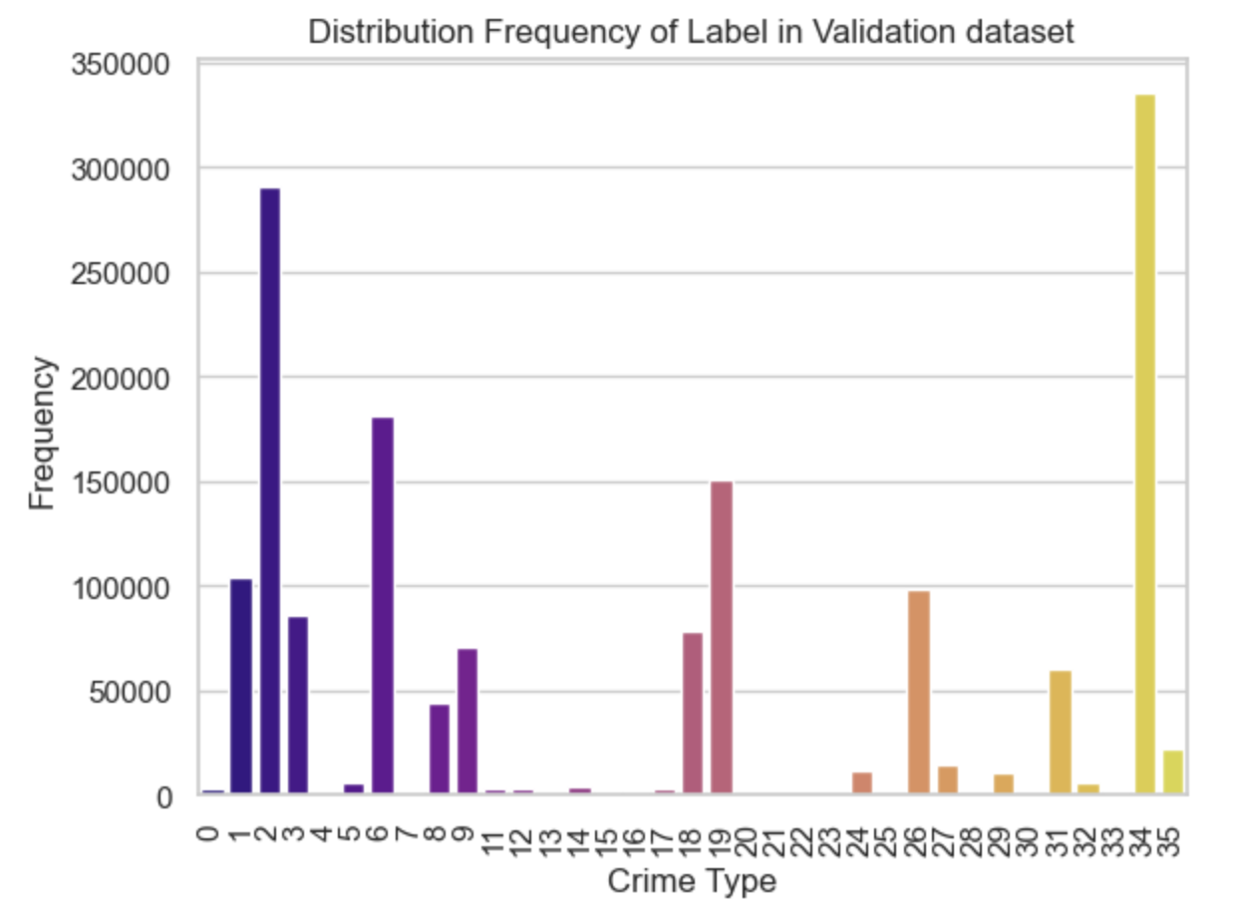
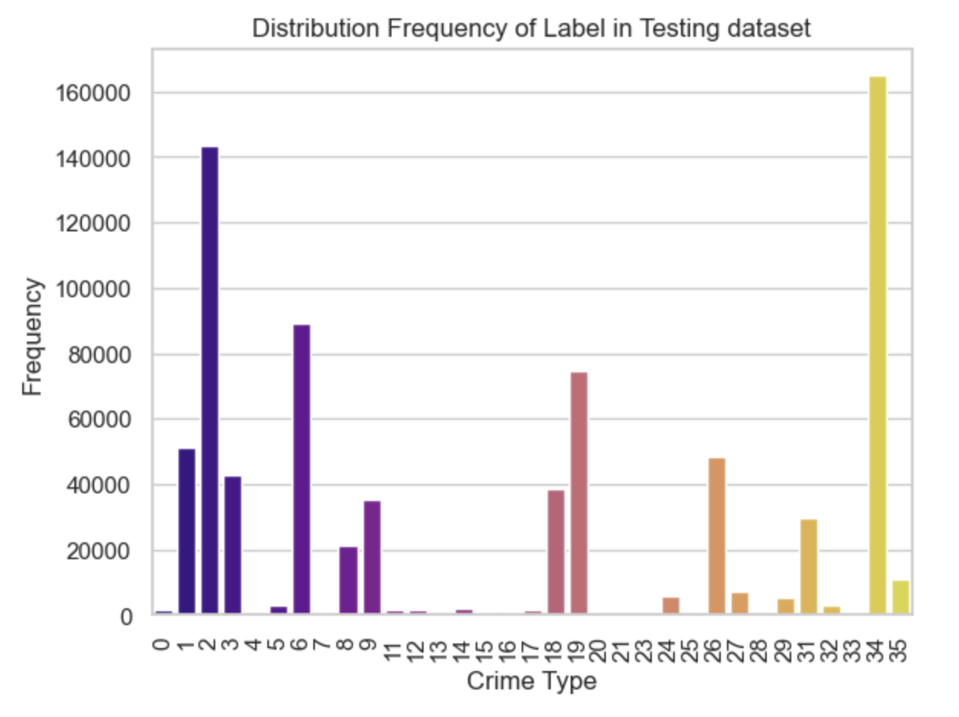
Data Statistics

Slide 31
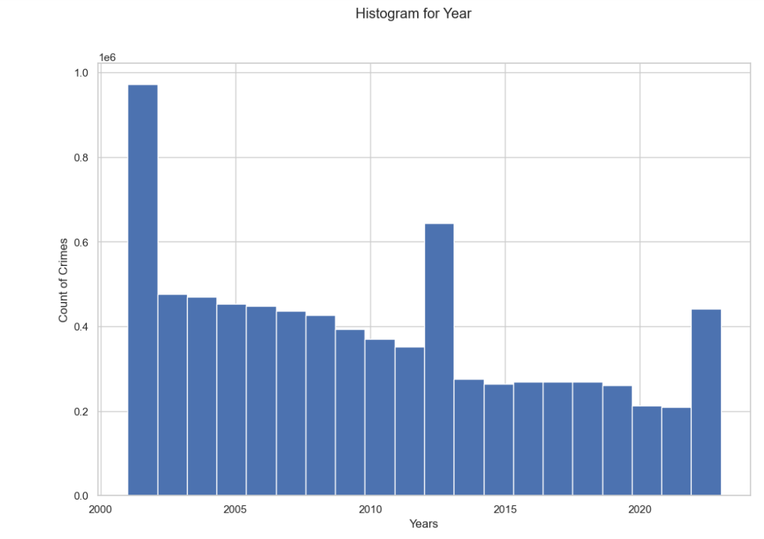
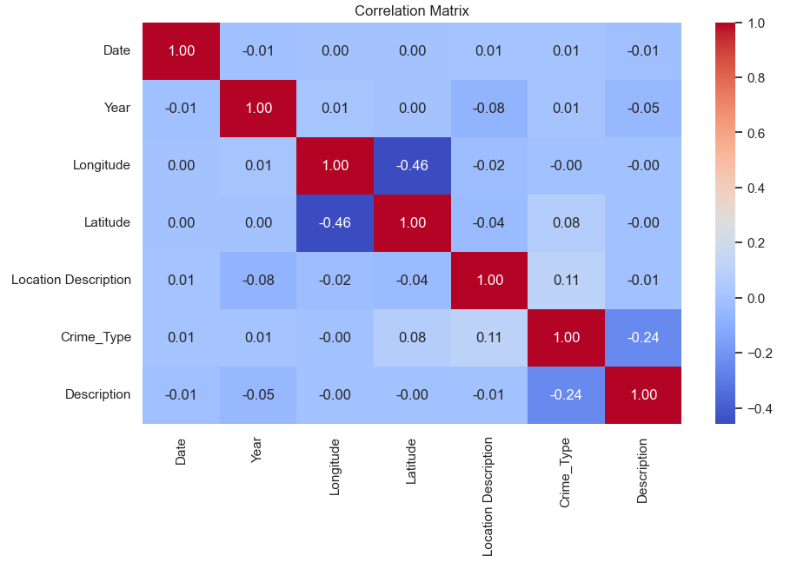
Data Analytics

Slide 32
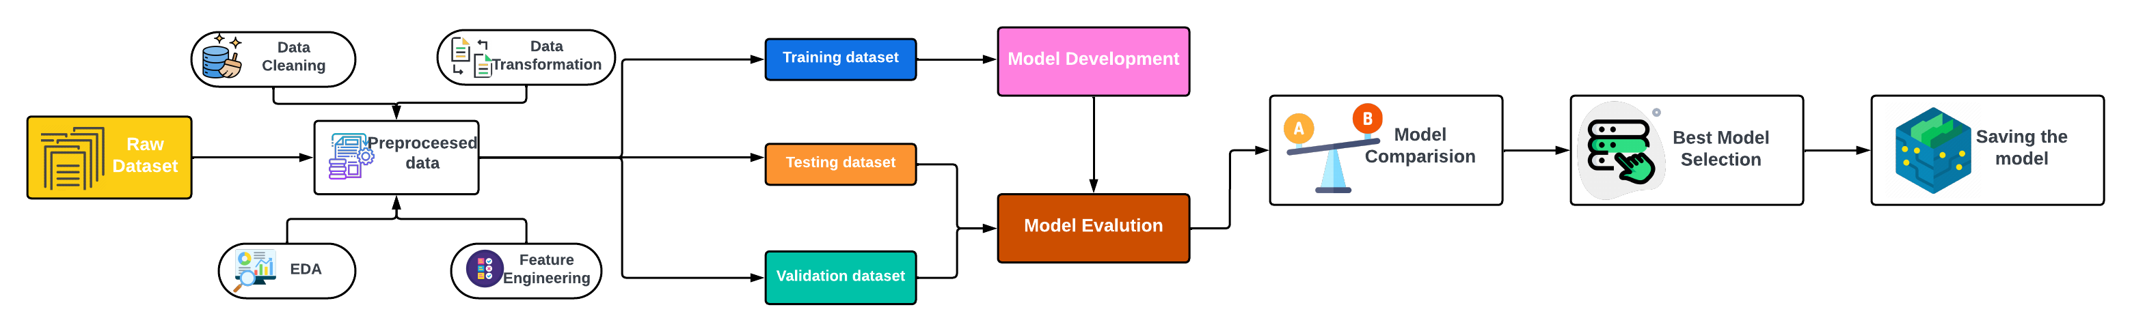
Project Architecture
Started with a raw dataset and preprocessed it using multiple techniques.
Divided the preprocessed dataset into 3 parts : 70% into Training, 20% into Validation and 10% into Testing.
Developed Machine Learning models on Training dataset.
Evaluated the performance of the models using Validation and Testing datasets.
Compared models based on evaluation metrics to find the best performing model.
Saved the Baseline and Hyper tuned best model.

Slide 33
Modelling
Model Proposals
Model Support
Model Building
Model evaluation and comparison
Our Best Model

Slide 34
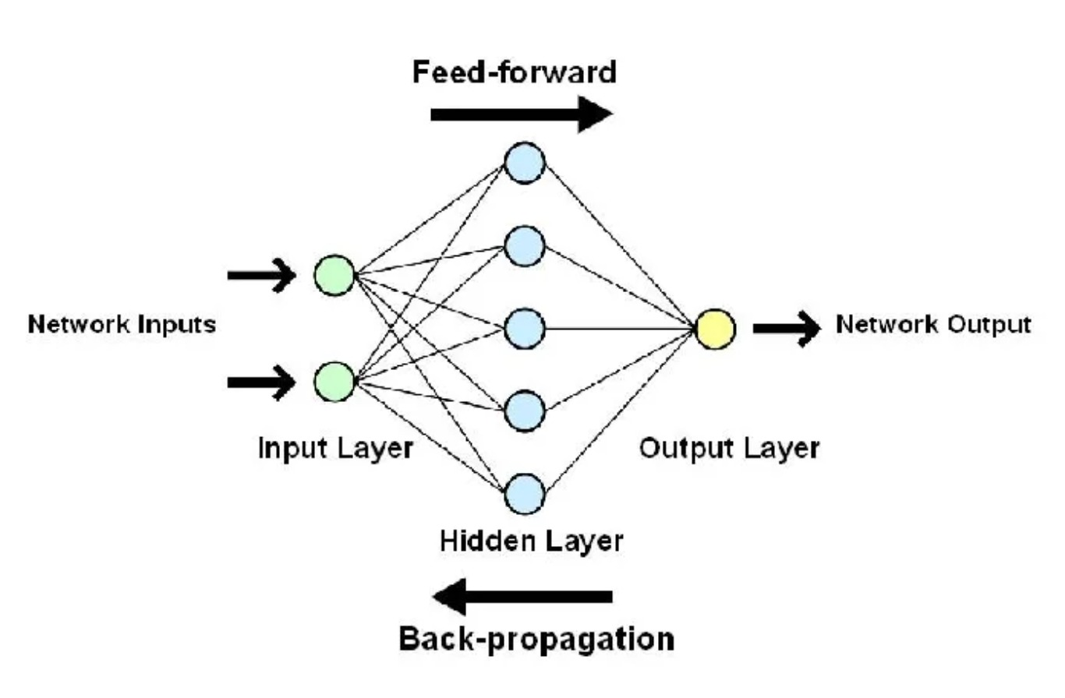
Model proposal-Artificial Neural Networks
A deep learning model inspired by the human brain’s structure.
Consists of three layers: input , hidden and output layers, connected by the neurons.
Feedforward phase: Input data is passed through the layers, producing a prediction.
Backward Phase: Evaluates the error and updates the weights to improve the performance.

Slide 35
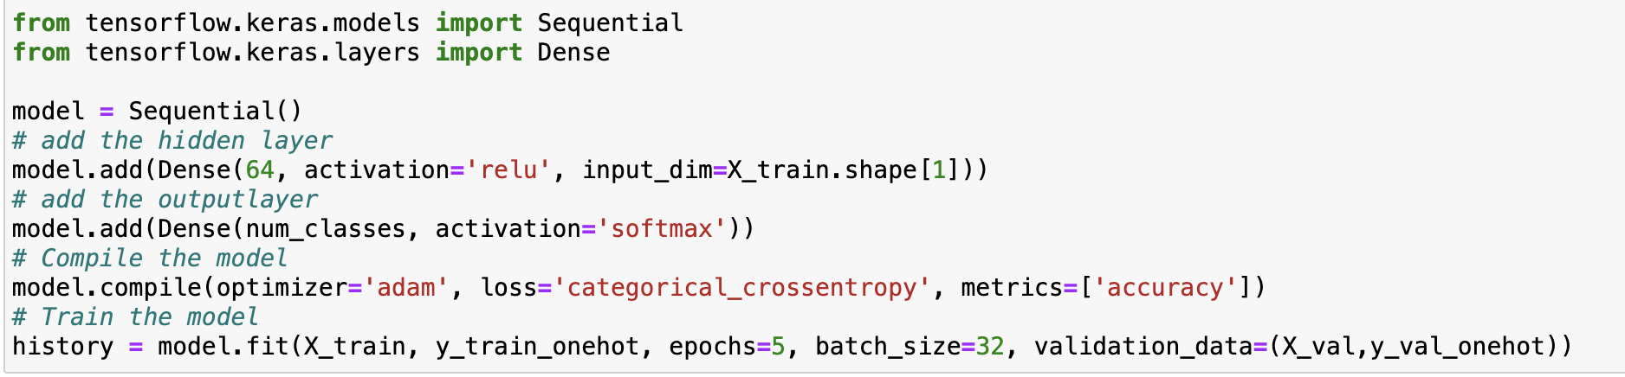
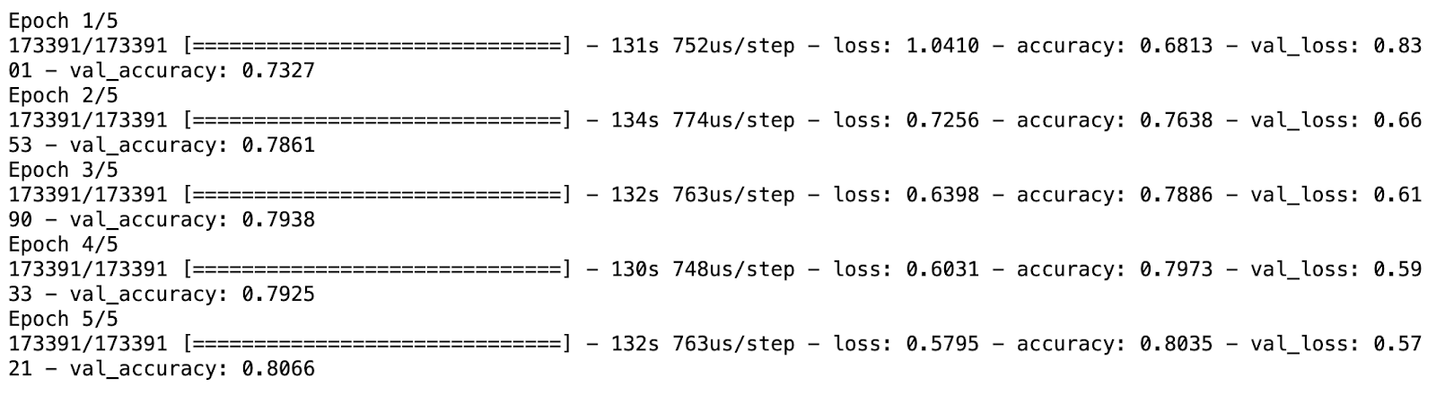
Model Support- Artificial Neural Networks
Baseline Model Implementation
Hyperparameters:
One hidden layer with 64 neurons
Epochs: Number of iterations over the entire dataset
Batch_size: number of instances processed before updating the weights
Loss: Loss function used to evaluate the model
Baseline Model Training Report

Slide 36
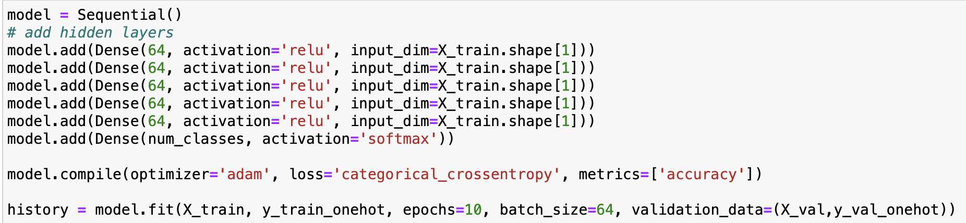
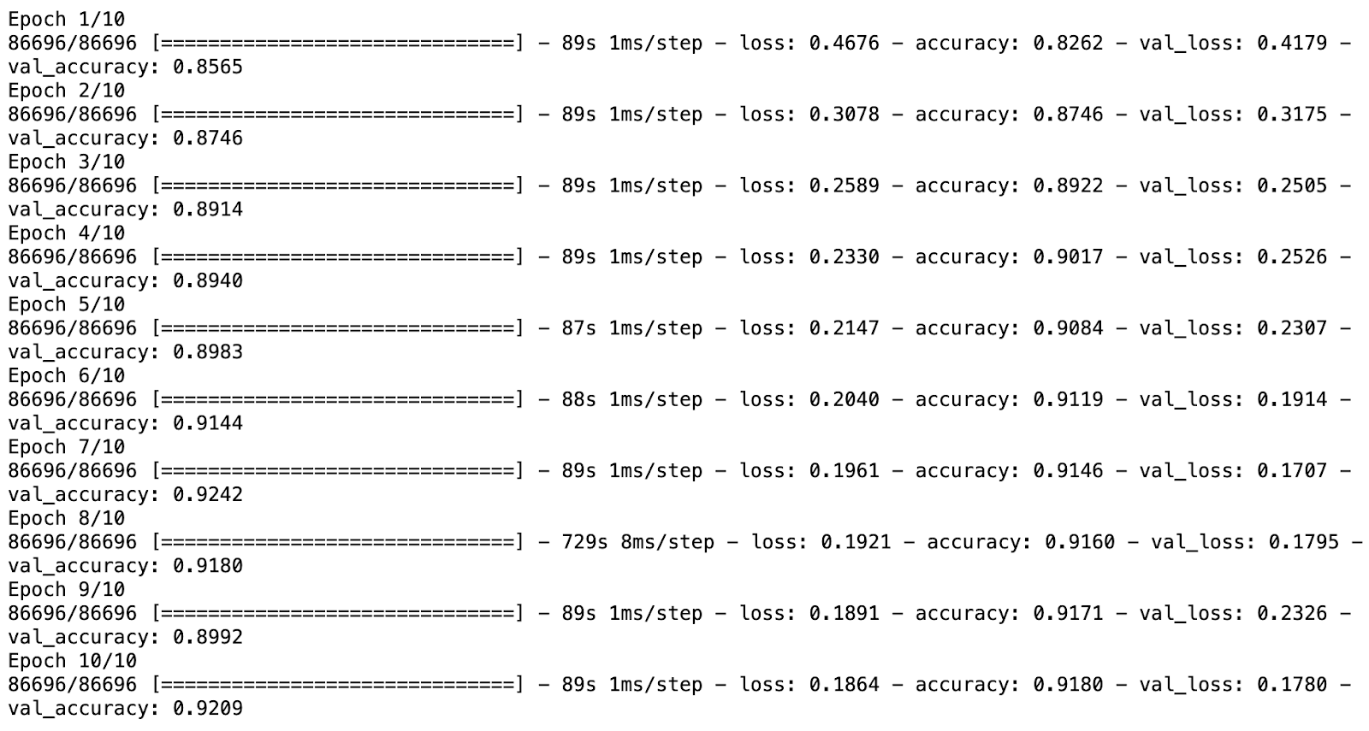
Model Building-Artificial Neural Networks
Hyperparameters:
Hidden Layers: 5
Nodes in hidden layers: 64
Epochs: 10
Batch_size: 64
Loss: Cross Entropy
Performance
After Hyper tuning the model, the accuracy increased from 81% to 92% and f1 score increased from 79% to 91%.
The running time decreases from 130s to 90s.

Slide 37
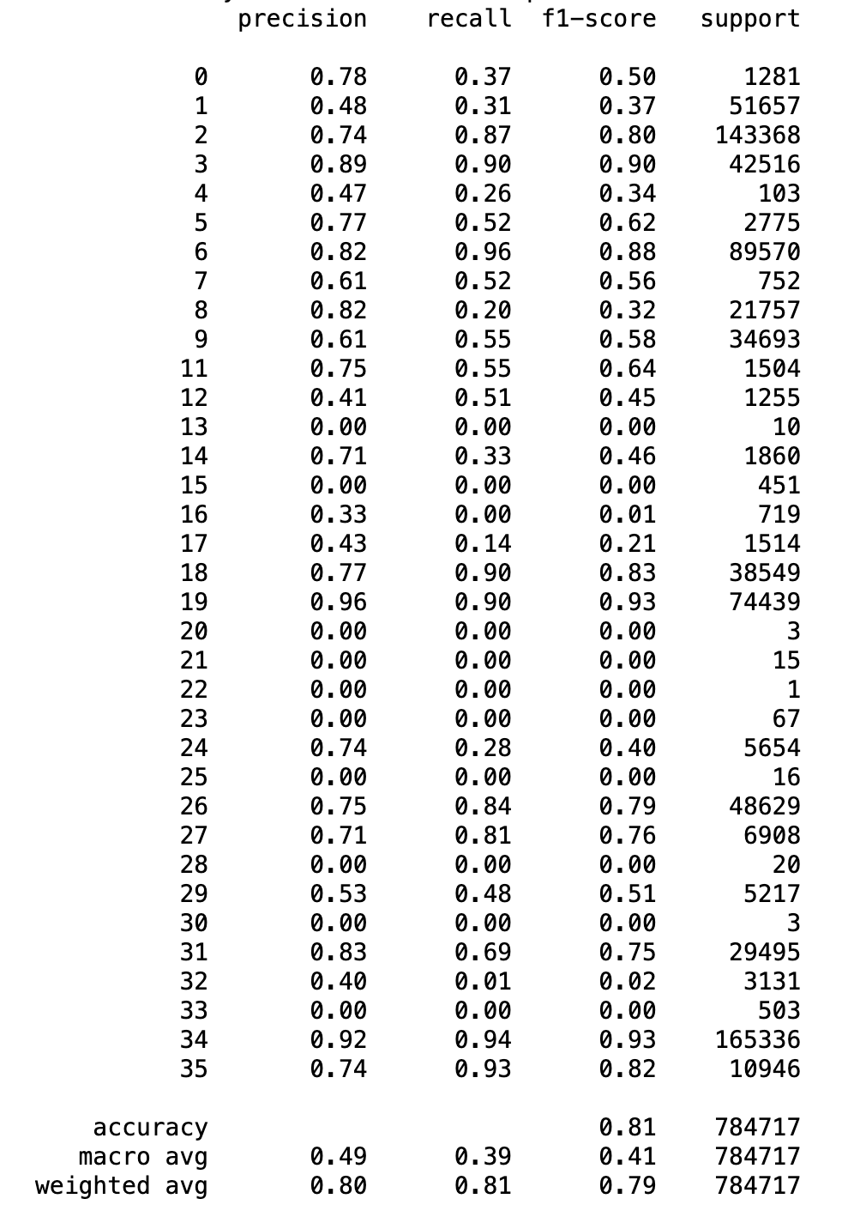
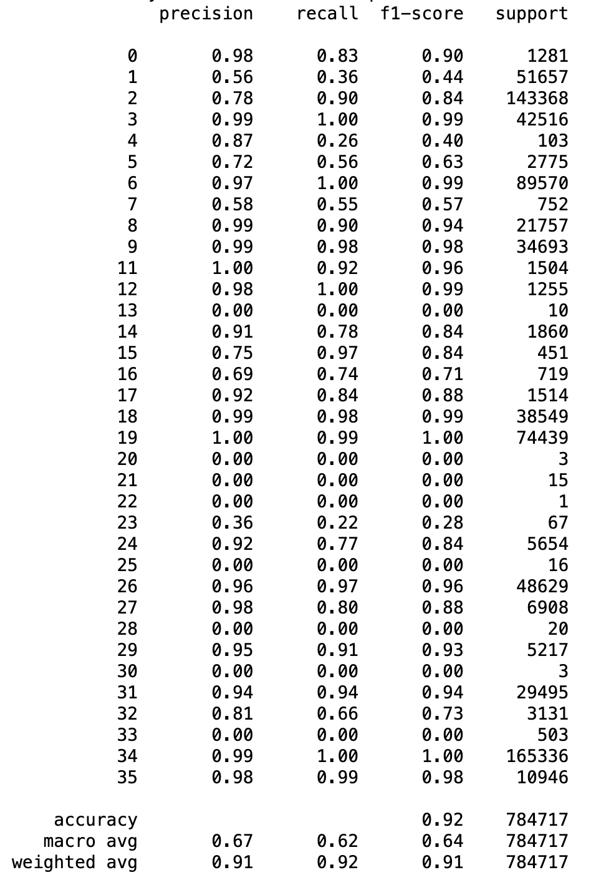
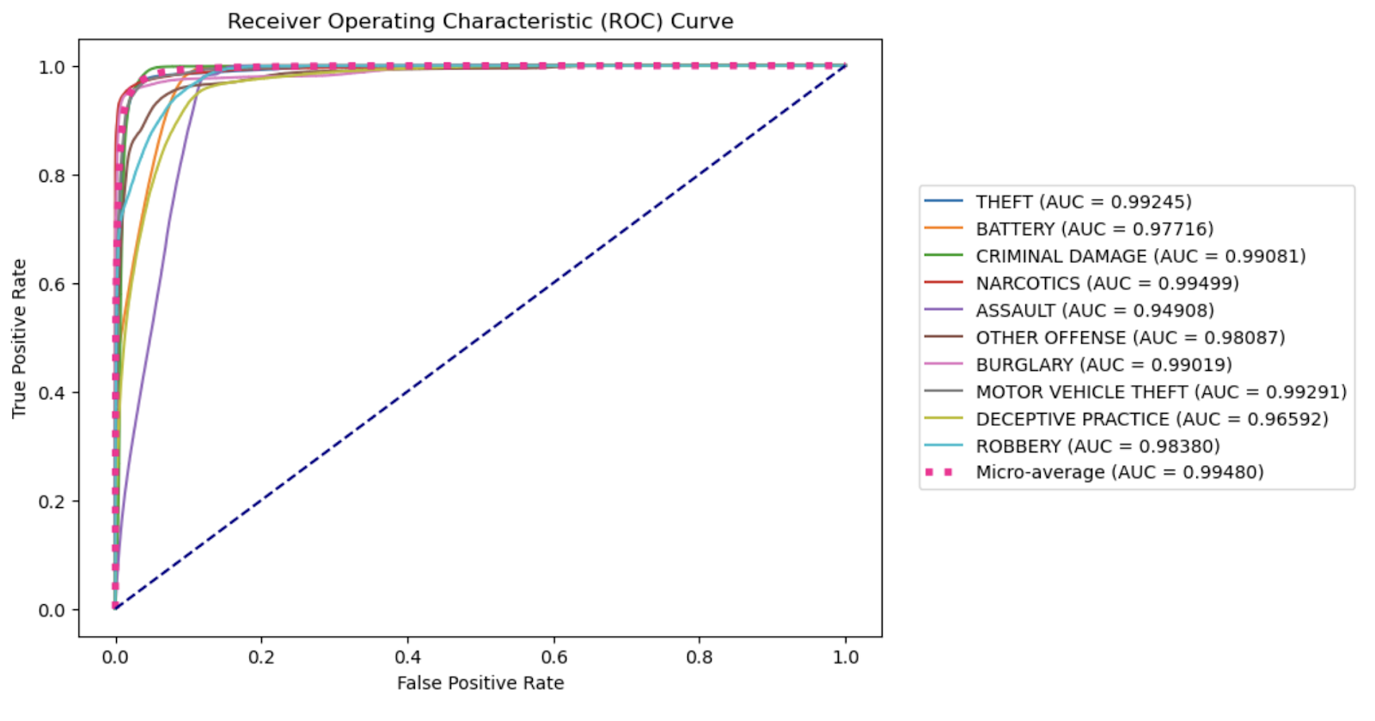
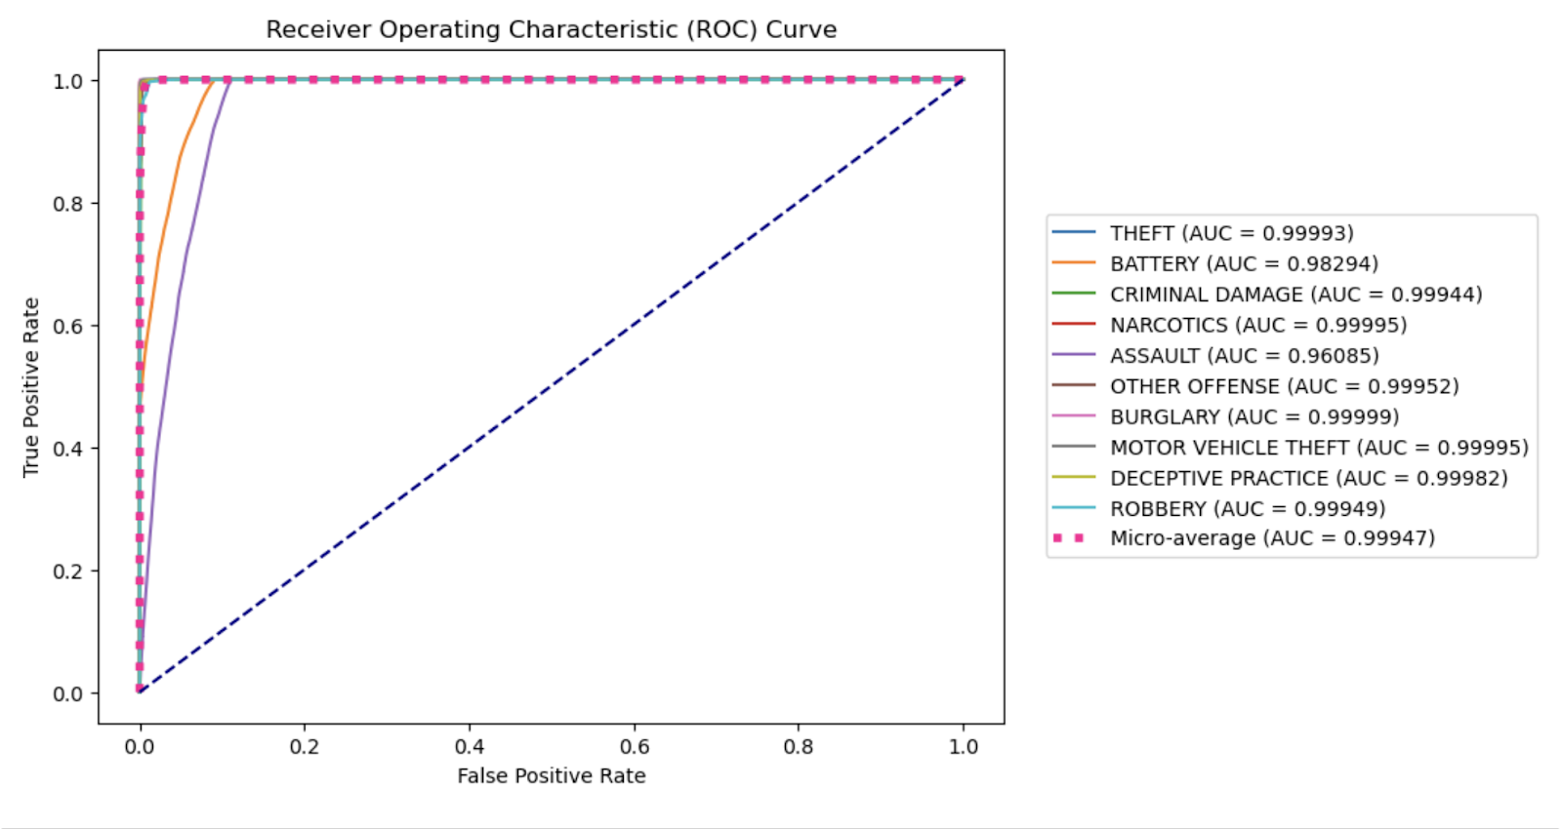
Model Evaluation- Artificial Neural Networks
Classification report Before Tuning
After Tuning
ROC Curve Before Tuning
After Tuning

Slide 38
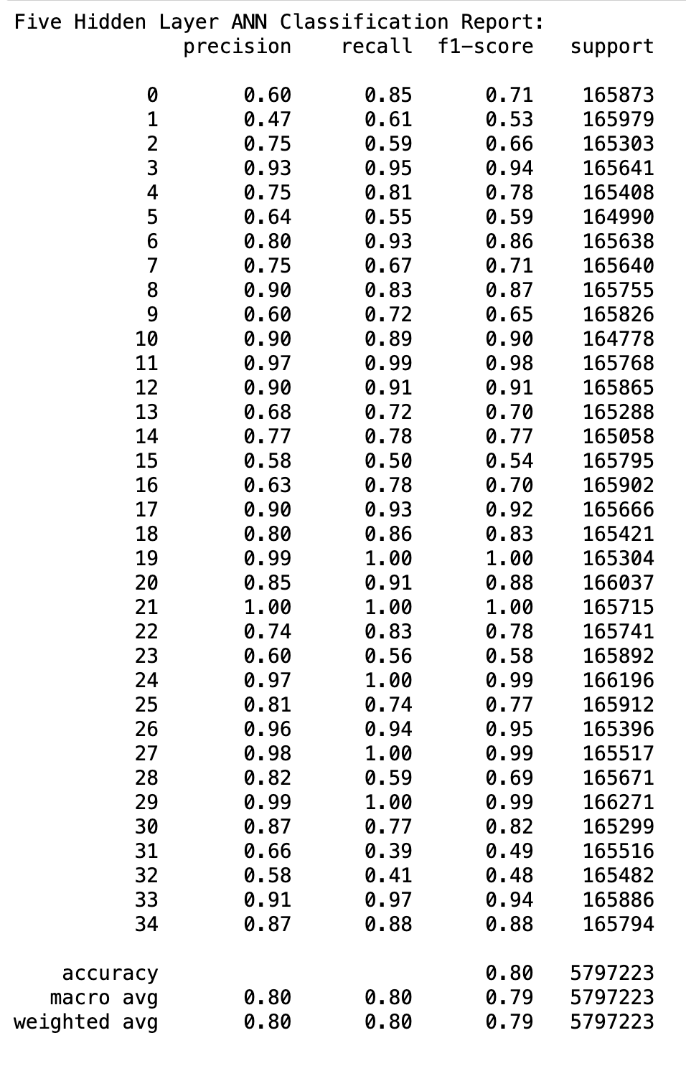
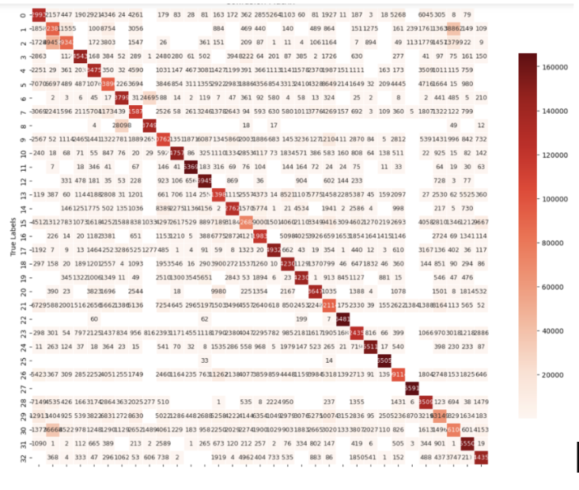
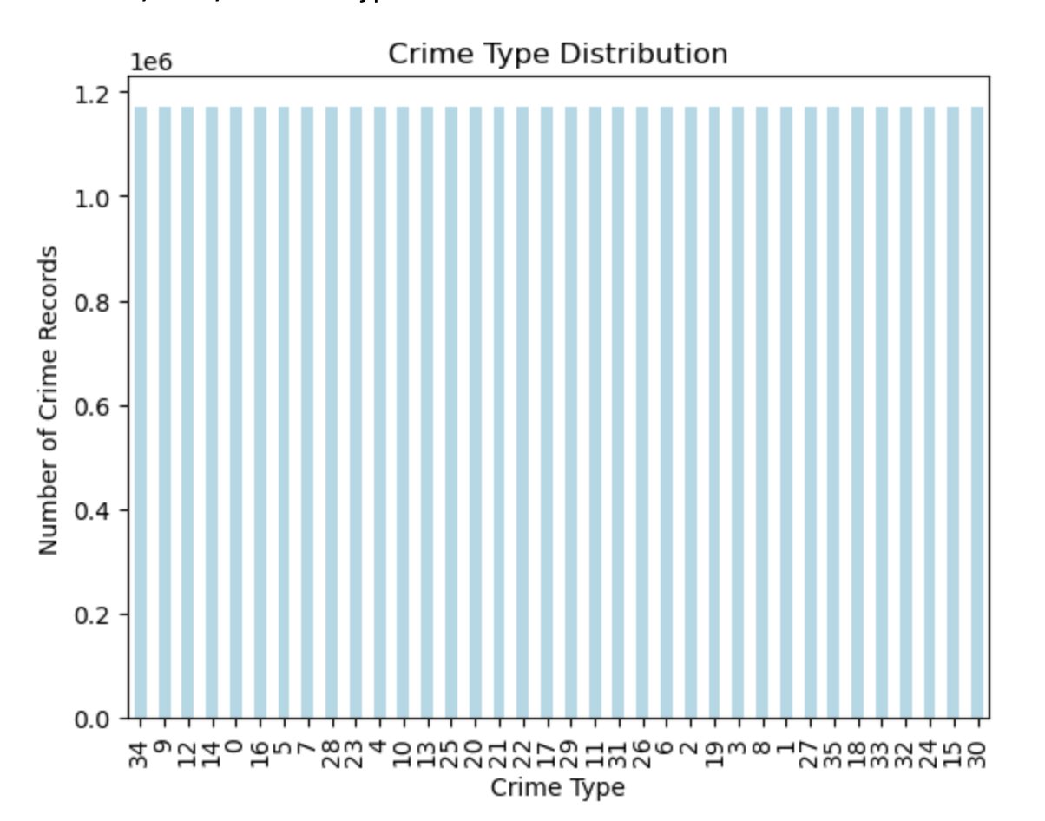
Model Evaluation- Artificial Neural Networks
Classification Report After Balancing
Confusion Matrix After Balancing
Crime Type Distribution
After Tuning

Slide 39
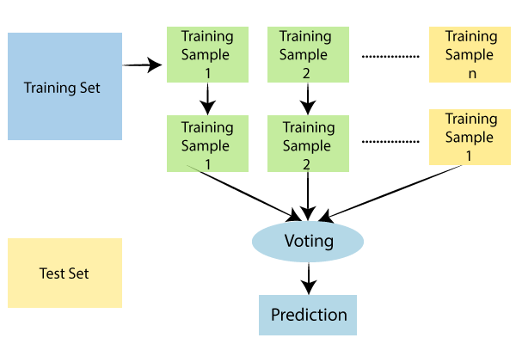
Model Proposal-Random Forest
Random Forest uses a combination of decision trees, enabling collaborative decision-making by multiple models.
The algorithm uses a voting system to reduce the risk of overfitting by taking into account the majority prediction from the group of trees.
Random Forest achieves high accuracy and efficiency in predictions by consolidating forecasts from multiple trees.
Studies, such as Abdulraheem M. et al.'s crime prediction and Guo et al.'s mining cost estimation, highlight the effectiveness of Random Forest in achieving accurate predictions and valuable insights.

Slide 40
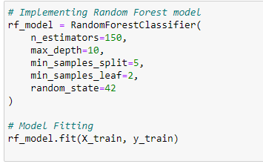

Model Support- Random Forest
Baseline Model
n_estimators: Determines number of decision trees in each forest.
max_depth: Maximum levels in each tree.
min_samples_split: Minimum number of branches for each tree.
min_samples_leaf: Minimum number of samples for each leaf node.
Based on the above parameters and their respective values, baseline model is built and its evaluation is done.
Based on the evaluations the model performed well but in an attempt to enhance the performance hyper parameter tuning is done using Grid search.

Slide 41



Model Building- Random Forest
Hypertuned Model
After Hyper tuning the model, the performance of the model progressed and the accuracy increased from 73% to 91% and f1 score from 70% to 91%.
Running time decreased from 7mins to 2mins

Slide 42




Model Evaluation- Random Forest
Classification report before Tuning
Classification report after Tuning

Slide 43


Model Evaluation-Random Forest
ROC curve before Tuning
ROC curve after Tuning

Slide 44

Model Proposal- XGBoost
XGBoost is an ensemble learning method that combines multiple decision trees sequentially, iteratively minimizing errors.
It employs gradient boosting, optimizing prediction accuracy by iteratively adding trees and correcting errors, using a gradient descent-based approach.
XGBoost achieves high performance across various tasks while handling diverse data types efficiently.
Study from research by Cheng Sheng et al and Haizheng Yu et al reveal the effectiveness of XGBoost in prediction highlights the potential of the models in tackling complex real-world problems with nonlinear relationships and multiple influencing factors.

Slide 45


Model Support -XGBoost
Baseline Model
XGBoost baseline model performed with 75 trees ('n_estimators'), 6 levels deep ('max_depth'), 0.1 learning rate.
Evaluated using 'mlogloss' ('eval_metrics') and 'multi:softmax' ('objective') on imbalanced data.
Dataset split: 70% for training, 20% for validation, and 10% for testing.
Training completed in roughly 5.86 seconds.
Model achieved 0.91 accuracy and 0.22 loss on validation, maintaining 0.90 accuracy on the test set.

Slide 46


Model Building -XGBoost
Baseline model achieved 0.90 accuracy, prompting hyperparameter tuning.
Employed GridSearchCV to optimize 'n_estimators' (100, 125) and 'learning_rate' (0.01) combinations.
n_estimators with 125 and learning rate as 0.01 are selected as best parameter.
Despite increased training time, both sets of hyperparameters yielded the same 90% accuracy on test data.
Tuning n_estimators and learning_rate at 0.01 didn't enhance accuracy despite longer training duration.
Highlighted the need for exploring other hyperparameters or techniques for potential improvement.

Slide 47


Model Evaluation- XGBoost
Classification report before Tuning
Classification report after Tuning
Before tuning Accuracy is 91% and f1 score is 90%
After tuning Accuracy is 90% and f1 score is 89%

Slide 48


Model Evaluation-XGBoost
ROC curve before Tuning
ROC curve after Tuning

Slide 49

Model Proposal-Decision Tree
Decision trees, a supervised learning algorithm and as a non-parametric classifier, provide a straightforward yet powerful approach with interpretability and automatic feature selection advantages.
The process of prediction in Decision Trees entails moving from the initial node to a final node, where each node makes a decision based on a particular characteristic, creating a hierarchical series of decision guidelines.
Insights from research by Rokach et al. and Ahishakiye et al. validate the practicality, simplicity, and transparency of decision trees in real-life situations, as well as enhancements to the decision tree algorithm.

Slide 50

Model Support-Decision Tree
Baseline Model:
Hyperparameters:
Criterion: 'gini'
Splitter strategy: 'best'
Max depth: None (unlimited growth) -
Min samples split: 2
Min samples leaf: 1
Min weighted fraction leaf: 0.0
Max features: None (consider all features)
Random state: None (allows non-deterministic behavior)
Performance:
Accuracy: 92.77%
Training time: 62.69 seconds

Slide 51


Model Building-Decision Tree
Hyperparameter Tuned Model
GridSearchCV: Utilized GridSearchCV for hyperparameter optimization
Duration: Approximately 8 hours for an extensive grid search
Best Hyperparameters: Criterion: 'entropy’, Max depth: 15 ,Max features: None ,Min samples leaf: 4 ,Min samples split: 5

Slide 52


Model Evaluation-Decision Tree
Classification report before Tuning
Classification report after Tuning
Accuracy: 93%, f1 score: 93%, before tuning.
Accuracy: 94% , f1 score:94%, after tuning.
Training time: 65.13 seconds
Generalization Assessment: Validated on an independent test set
Insights into effectiveness and reliability of the trained decision tree

Slide 53


Model Evaluation-Decision Tree
ROC curve before Tuning
ROC curve after Tuning

Slide 54
Model Comparison
Model | Advantages | Disadvantages | Perfromance
Random Forest | • Ensemble method contributes to model robustness • Different trees can be built simultaneously • Provides high accuracy • Works with both categorical and numerical variables | • Less Interpretable than DT • Computationally expensive on large dataset • Biased toward the dominant class | After Hyper tuning the model, the performance of the model progressed and the accuracy increased from 73% to 91% and f1 score from 70% to 91%. Running time decreased from 7mins to 2mins.
Decision Tree（C4.5） | • Provides human-readable prediction • Adapt to both categorical and numerical attributes • Can handle missing values • Scalable to large datasets | • Sensitive to noisy data and outliers • Designed for classification, limit support for regression • Easily lead to overfitting | Accuracy: 93%, f1 score: 93%, before tuning. Accuracy: 94% , f1 score:94%, after tuning. Training time: 65.13 seconds
XGBoost | • High accuracy and performance on various datasets • Faster than traditional algorithm using parallel processing • Includes regularization terms to reduce overfitting • Handling data imbalance and missing values | • Hard to find the optimal set of hyperparameters • Computationally expensive, especially for large datasets • Require large amount of memory • Sensitive to outliers and noises | Increased training time Before tuning Accuracy is 91% and f1 score is 90% After tuning Accuracy is 90% and f1 score is 89%
ANN | • Achieves high accuracy by learning autonomously from data • Ability to capture the complex patterns of data • Can handle incomplete or noisy data • Generalizes well to unseen data | • Require large amount of data for training • Computationally intensive for deep neural networks • Model performance affected by data preprocessing • Black box nature makes it hard to interpret | After Hyper tuning the model, the accuracy increased from 81% to 92% and f1 score increased from 79% to 91%. The running time decreases from 130s to 90s.

Slide 55

Our best model
The results show that the decision tree model is the best model for this task.
It has the highest accuracy, precision, recall, and F1-score.
The random forest model is the second best model, followed by the XGBoost and ANN models.
We selected Decision Tree instead of Random Forest because DTs is more interpretable and easier to visualize than Random Forest also Random Forest is computationally intensive and is taking more time for training when compared to decision tree.
The decision tree model was also saved using the joblib library, so that it can be used to make predictions on new data in the future.

Slide 56

Summary
The project's goal is to use machine learning and historical crime data to proactively identify high-risk areas for criminal behavior. Traditional methods of reactive crime prevention have limitations in adapting to changing threats, so the project aims to optimize law enforcement resources and increase public safety using predictive models such as ANN, Decision Tree, XGBoost, and Random Forest. By analyzing crime patterns and demographics, the initiative seeks to foster safer communities through early intervention strategies while minimizing societal and economic impacts.

Slide 57
Future Scope
Integrating diverse dataset from all over the world and not limited to the city of Chicago.
Big data integration such as including public records and sensor data.
Implementing Geographic information system (GIS) to visualize crime pattern.

Slide 58
References
https://www.researchgate.net/publication/340969457_Crime_Prediction_Using_K-Nearest_Neighboring_Algorithm
https://www.ijcit.com/archives/volume6/issue3/Paper060308.pdf
https://www.ncbi.nlm.nih.gov/pmc/articles/PMC8529125/
https://www.irjet.net/archives/V5/i9/IRJET-V5I9192.pdf
https://www.ncbi.nlm.nih.gov/pmc/articles/PMC8081790/pdf/42492_2021_Article_75.pdf
https://www.irjmets.com/uploadedfiles/paper/issue_6_june_2022/27431/final/fin_irjmets1657108227.pdf
https://ieeexplore-ieee-org.libaccess.sjlibrary.org/stamp/stamp.jsp?tp=&arnumber=8821168
https://ieeexplore.ieee.org/abstract/document/8113405
https://www.mdpi.com/2079-3197/9/2/24
https://www-sciencedirect-com.libaccess.sjlibrary.org/science/article/pii/S0301420718306901?via%3Dihub
https://core.ac.uk/reader/560325700
https://link.springer.com/content/pdf/10.1023/A:1010933404324.pdf
https://ieeexplore-ieee-org.libaccess.sjlibrary.org/stamp/stamp.jsp?tp=&arnumber=9985004
https://ieeexplore-ieee-org.libaccess.sjlibrary.org/stamp/stamp.jsp?tp=&arnumber=8734193
https://arxiv.org/pdf/1603.02754.pdf
https://www.sciencedirect.com/science/article/abs/pii/S0927025619307712?via%3Dihub

Slide 59

Thank you

